Slide 1
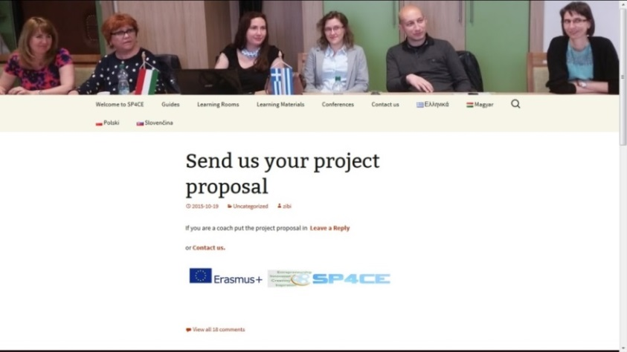
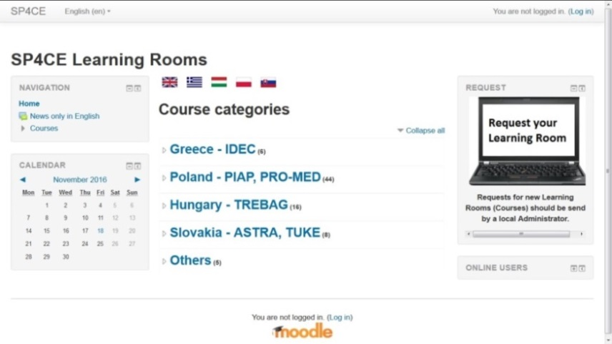
Invitation to the SP4CE Anna Czaja, Ewa Kozłowska, Paulina Pałasz
SP4CE stands for Strategic Partnership for Creativity and Entrepreneurship ERASMUS+ project.
Partners: PIAP (Poland), IDEC (Greece), TREBAG (Hungary), PRO-MED (Poland), TUKE (Slovakia), ASTRA (Slovakia).
Project aims at design and elaboration of innovative common tools (portal) for collaboration between students, enterprises and schools.
Welcome to http://sp4ce.eu and send us your project proposal.
The most interesting projects will be invited
to the workshop at eTEE 2017 in Gdansk
The SP4CE portal concept is based on the following coaching and mentoring principles:
Companies willing to find young workers send a project (e.g. problem to be solved).
The case is presented to students.
Based on proposed solutions the company selects the student(s) and give them coach(es) who co-work with students.
Mentors (teachers) from universities guide students in Learning Rooms.
Welcome to http://sp4ce.moodle.pl
This poster reflects the views only of the authors. The Commission cannot be responsible
for any use which may be made of the content/information contained in the article.

