Slide 1
Autodesk Fusion 360 Training: The Future of Making

Slide 2
Fusion 360 Training: The Future of Making Things
The following lessons utilize three different phases to each lesson’s learning cycle:
Lecture
Demonstration
Activity
Lecture (tell)
Demonstrate (show)
Activity (do)

Slide 3
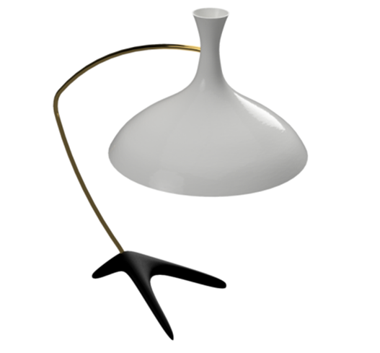
Fusion 360 Training: The Future of Making Things
Hands-on project based exercises will provide the skills necessary to develop basic knowledge of environment management, 3D modeling, assembly connections and other Fusion 360 skills.
Create sketches
Part modeling
Assemblies
Orthographic drawings
3D printing

Slide 4
Fusion 360 Training: The Future of Making Things
Students will have created a desktop lamp, created bodies and components that form an assembly, created orthographic drawings and exported a file of a component for production on a 3D printer.
There will be supplied files used throughout the hands-on exercises
Remember to save your files after each lesson
Explore techniques beyond the basic instruction during hands-on time

Slide 5
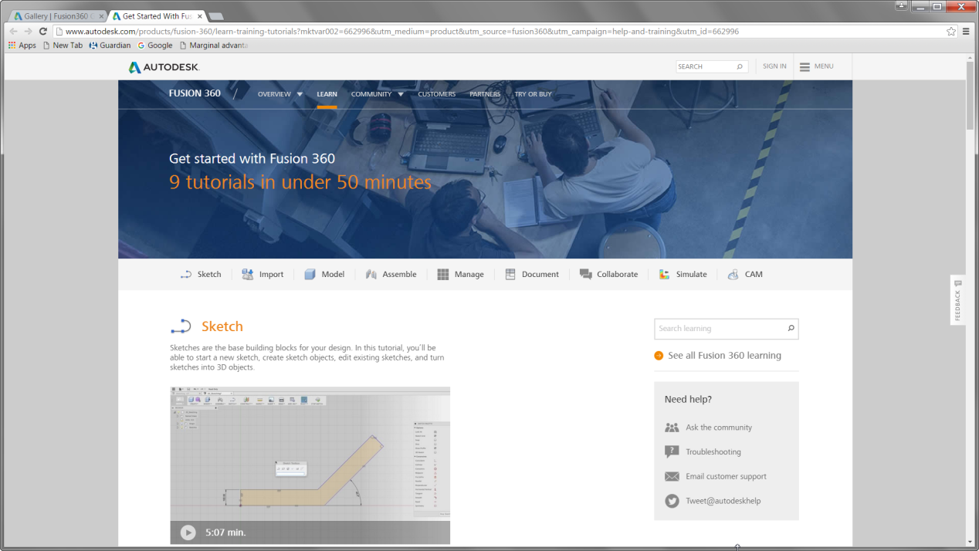
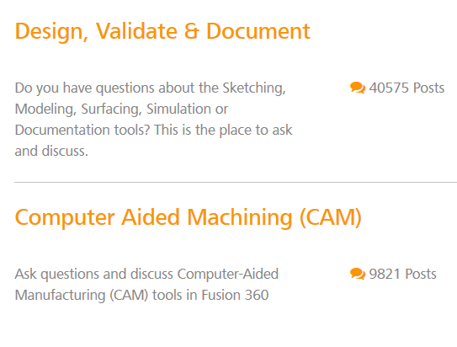
Fusion 360 Training: The Future of Making Things
Fusion Resources
Design Academy
Help and Tutorial
The Fusion 360 Gallery
Fusion 360 Forum

Slide 6
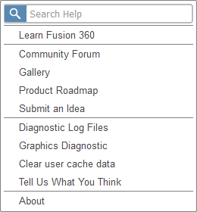
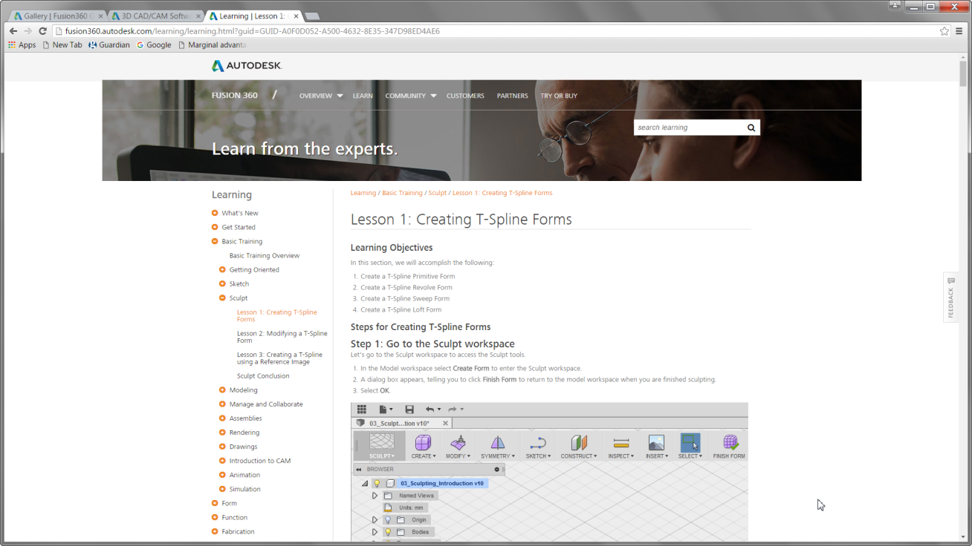
Fusion 360 Training: The Future of Making Things
Help and Tutorial Resources
Help via the icon on Application Bar
Tutorial topics categorized under functional subjects
Help content is video based and hosted on a web page

Slide 7
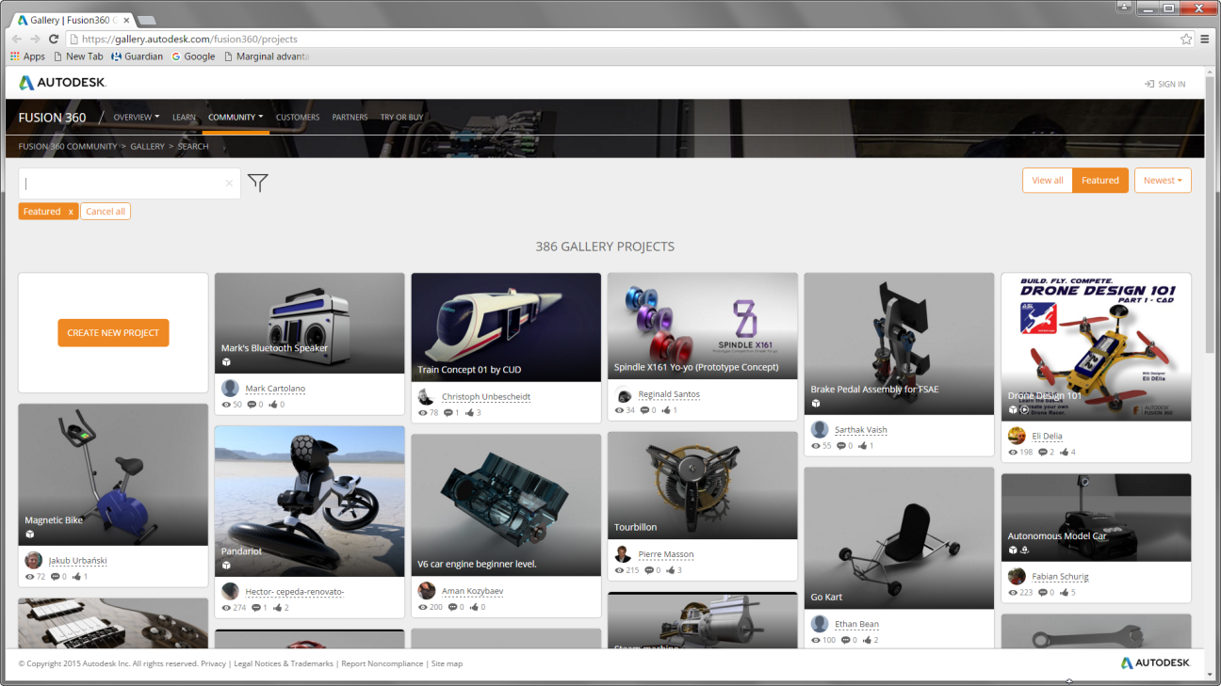
Fusion 360 Training: The Future of Making Things
Gallery
Post your images and even the data files
Topics categorized under functional subjects
Help content is video based and hosted on a web page
Publish from your design

Slide 8
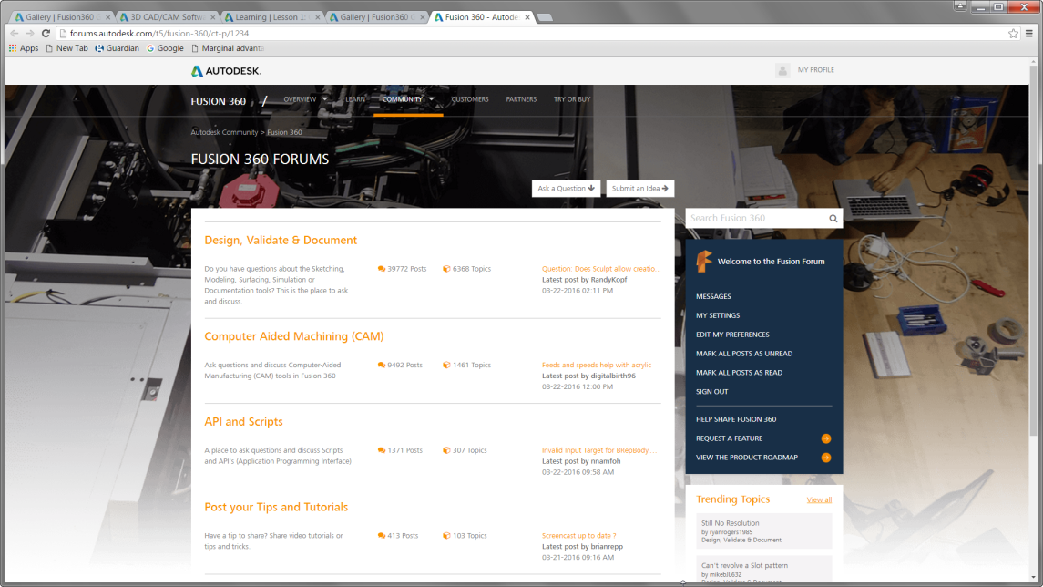
Fusion 360 Training: The Future of Making Things
Community Forum: Direct user
support
Addressable from
The Application Bar
The Community list on the Fusion 360 page

Slide 9
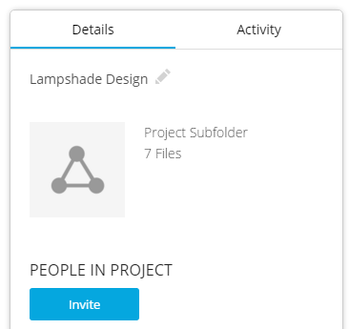
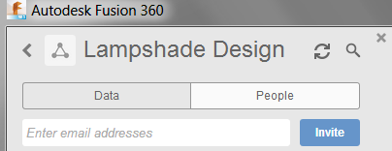
Fusion 360 Training: The Future of Making Things
Sharing projects for a class
Projects store data created by those who are members
Others can be invited to those projects using an e-mail address
This address should be associated with the Student’s Autodesk ID
The link for inviting collaborators can be found on the Autodesk A360 page or from the individual Project or in the “All Projects” space

Slide 10
Training
Notes:
I would like to pause now and thank you for you attention and for taking the time to hear about Autodesk’s Digital Prototyping concept.
I value your opinion of my presentation and its contents and at this time I would like to welcome all question or comments.
[After Q&A is complete]
<Next Slide>

Slide 11
Fusion 360 Training: The Future of Making Things
Workshop Objectives
After completing the training, the attendee will be able to:
Identify the main areas of the Autodesk Fusion 360 interface
Describe the main work environments in Autodesk Fusion 360
Create a new components using T-Spline and Solid modeling tools
Join components as an assembly
Create drawings of parts including projected views, and annotations
Output a part for 3D printing

Slide 12
Fusion 360 Training: The Future of Making Things
Workshop Lessons
Overview
Sketch
Model
Model the stem
Sculpt
Assemble
Document
Render
Export
Collaborate

Slide 13
Fusion 360 Training: The Future of Making Things
Lesson 1: Overview
Objectives
Review an Autodesk ID
Start Fusion 360
Create a new project

Slide 14
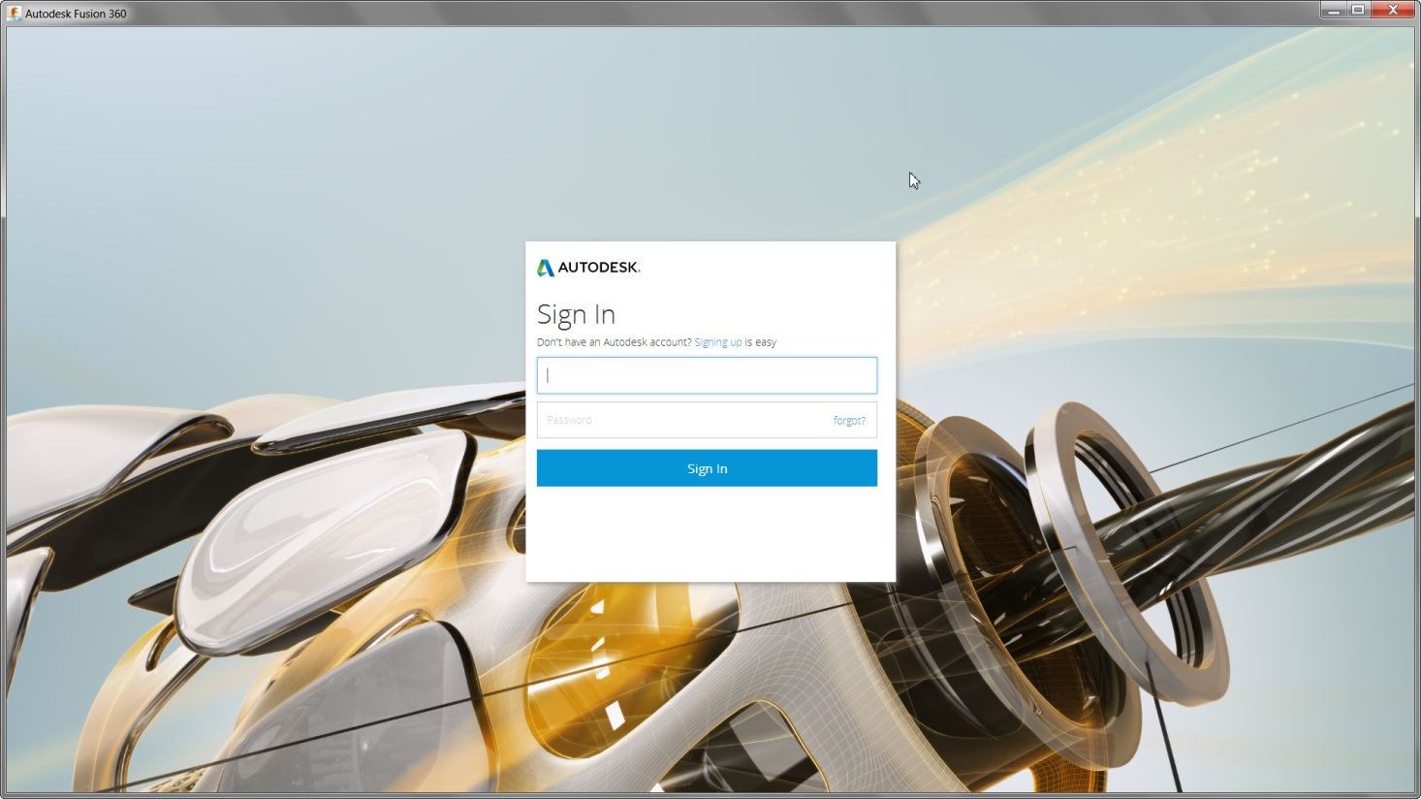
Fusion 360 Training: The Future of Making Things
Demonstration

Slide 15
Fusion 360 Training: The Future of Making Things
Lesson 1: Dashboard and Projects
Review
Review an Autodesk ID
Start Fusion 360
Create a new project

Slide 16
Fusion 360 Training: The Future of Making Things
Lesson 2: Sketch
Objectives
Create a new design
Sketch the profile of the lampshade

Slide 17
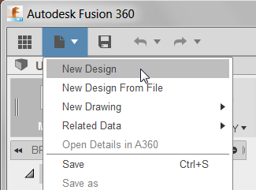
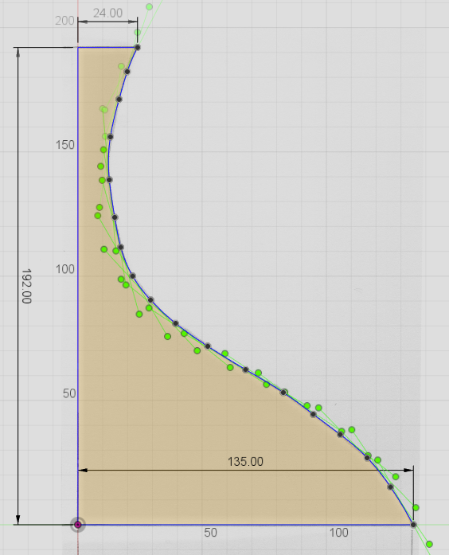
Fusion 360 Training: The Future of Making Things
Demonstration

Slide 18
Fusion 360 Training: The Future of Making Things
Lesson 2: Creating a Freeform shape using T-Splines technology
Review
Create a new design
Sketch the profile of the lampshade

Slide 19
Fusion 360 Training: The Future of Making Things
Lesson 3: Model
Objectives
Create a solid model of the lampshade
Shell the model
Modify the physical material and appearance
Add a hole for the wiring

Slide 20
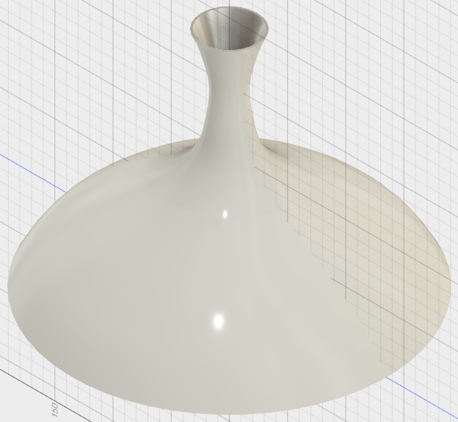
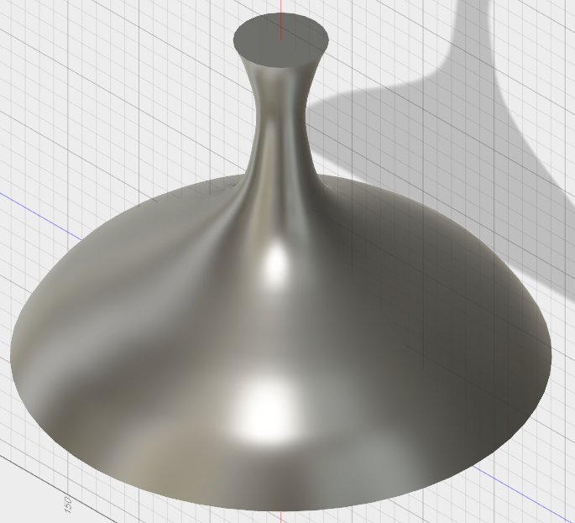
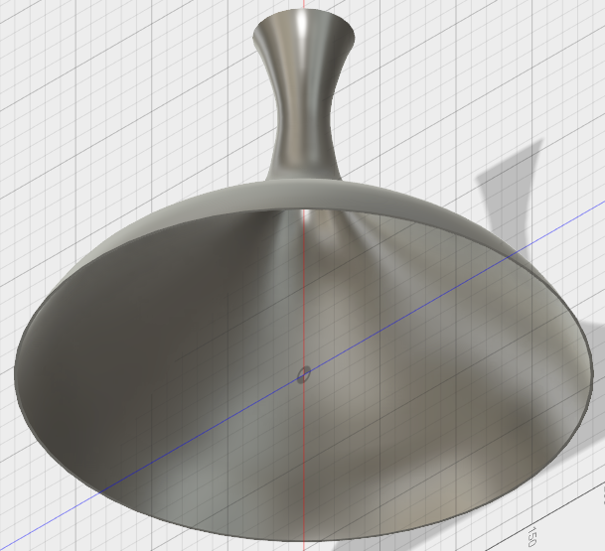
Fusion 360 Training: The Future of Making Things
Demonstration

Slide 21
Fusion 360 Training: The Future of Making Things
Lesson 3: Model
Review
Create a solid model of the lampshade
Shell the model
Modify the physical material and appearance
Add a hole for the wiring

Slide 22
Fusion 360 Training: The Future of Making Things
Lesson 4: Model the Arm
Objectives
Create a solid model of the arm
Modify the physical material and appearance
Add a hole for the wiring

Slide 23
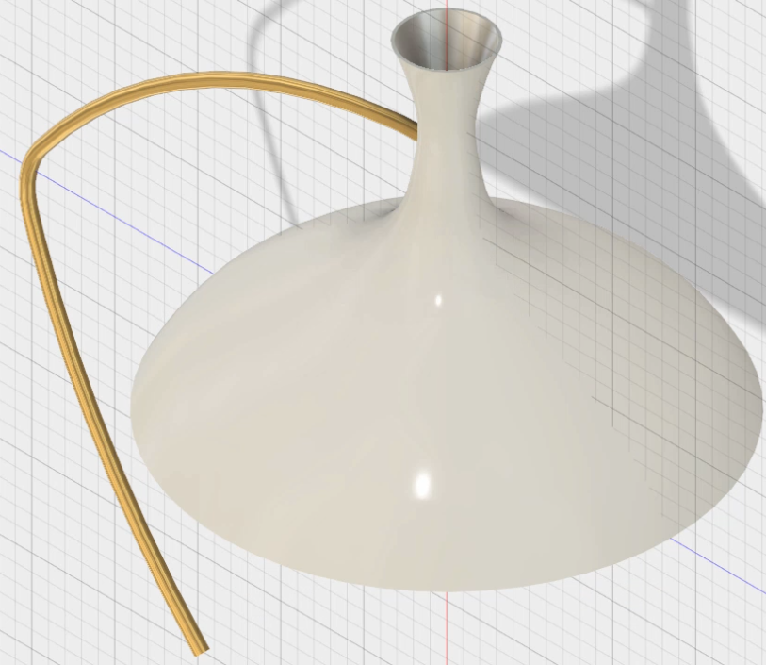
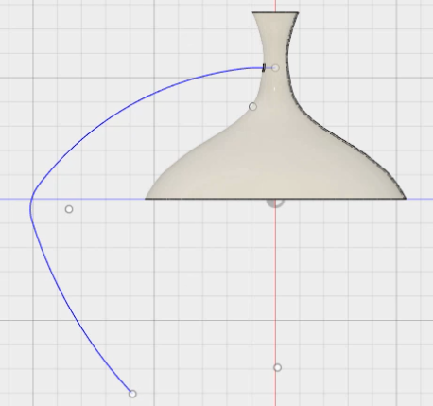
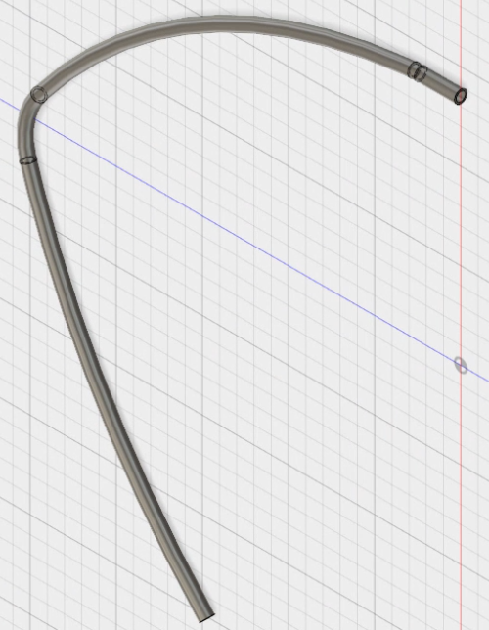
Fusion 360 Training: The Future of Making Things
Demonstration

Slide 24
Fusion 360 Training: The Future of Making Things
Lesson 4: Model the stem
Review
Create a solid model of the arm
Modify the physical material and appearance

Slide 25
Fusion 360 Training: The Future of Making Things
Lesson 5: Sculpt
Objectives
Create a new design
Sculpt a model for the stand
Add a hole for the wiring connection
Modify the physical material and appearance

Slide 26
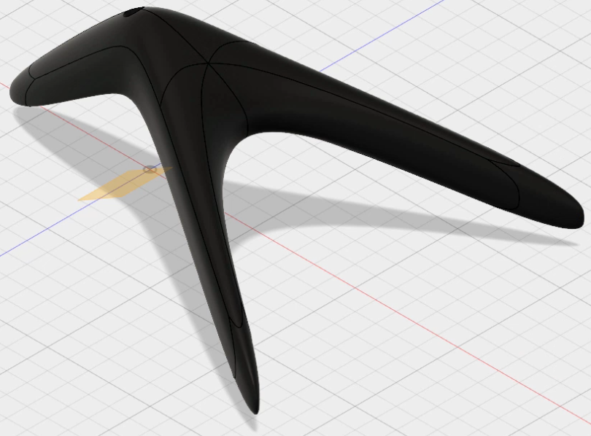
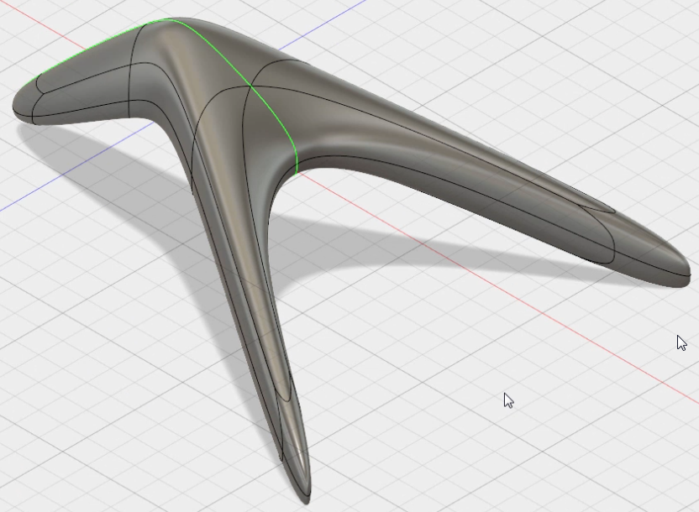
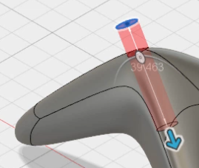
Fusion 360: The Future of Making Things
Demonstration

Slide 27
Fusion 360 Training: The Future of Making Things
Lesson 5: Sculpt
Review
Create a new design
Sculpt a model for the stand
Add a hole for the wiring connection
Modify the physical material and appearance

Slide 28
Fusion 360 Training: The Future of Making Things
Lesson 6: Assemble
Objectives
Modify the arm
Assemble the lamp using joints

Slide 29
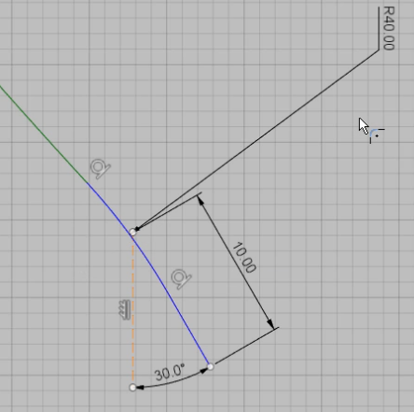
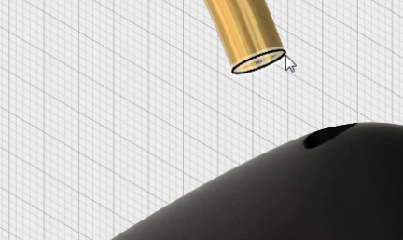
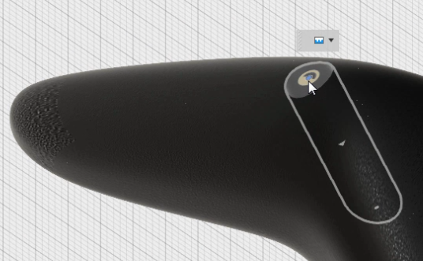
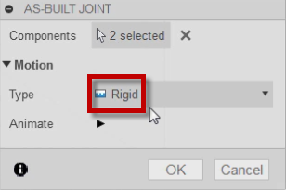
Fusion 360 Training: The Future of Making Things
Demonstration

Slide 30
Fusion 360 Training: The Future of Making Things
Lesson 6: Assemble
Review
Modify the arm
Assemble the lamp using joints

Slide 31
Fusion 360 Training: The Future of Making Things
Lesson 7: Document
Objectives
Create orthographic drawings of the lampshade
Add dimensions and text

Slide 32
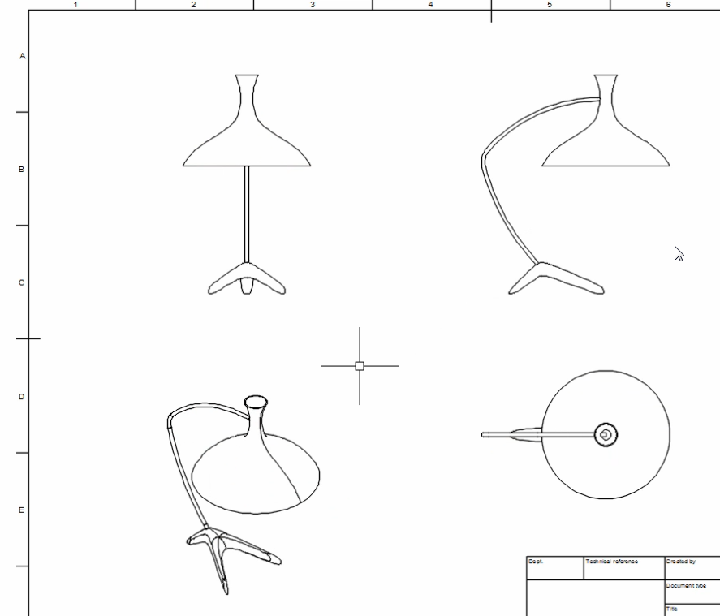
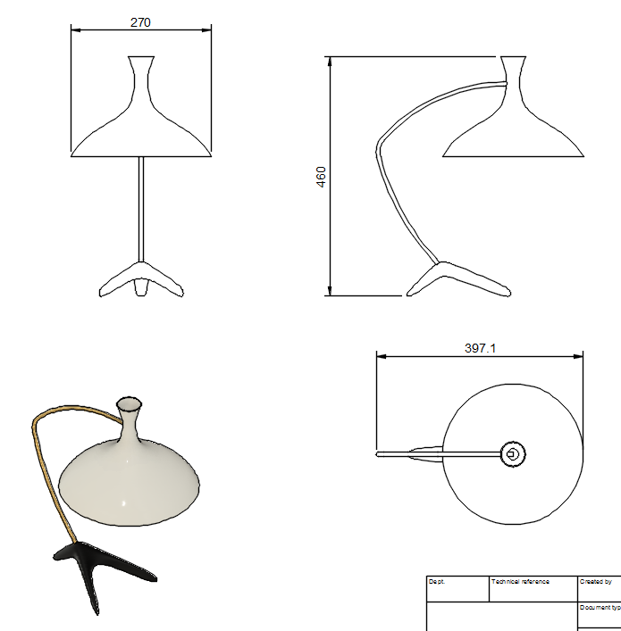
Fusion 360 Training: The Future of Making Things
Demonstration

Slide 33
Fusion 360 Training: The Future of Making
Lesson 7: Orthographic drawings
Review
Create orthographic drawings of the lampshade
Add dimensions and text

Slide 34
Fusion 360 Training: The Future of Making Things
Lesson 8: Render
Objectives
Create rendered images of the lamp

Slide 35
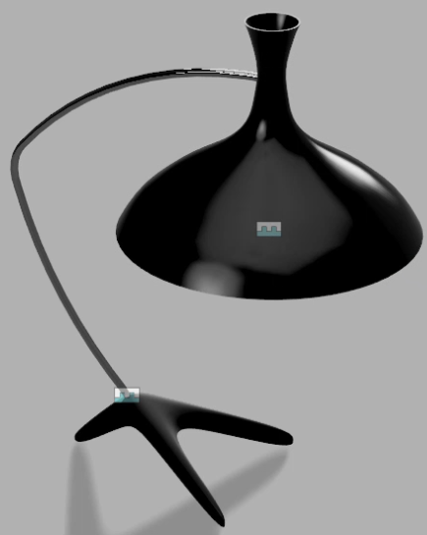
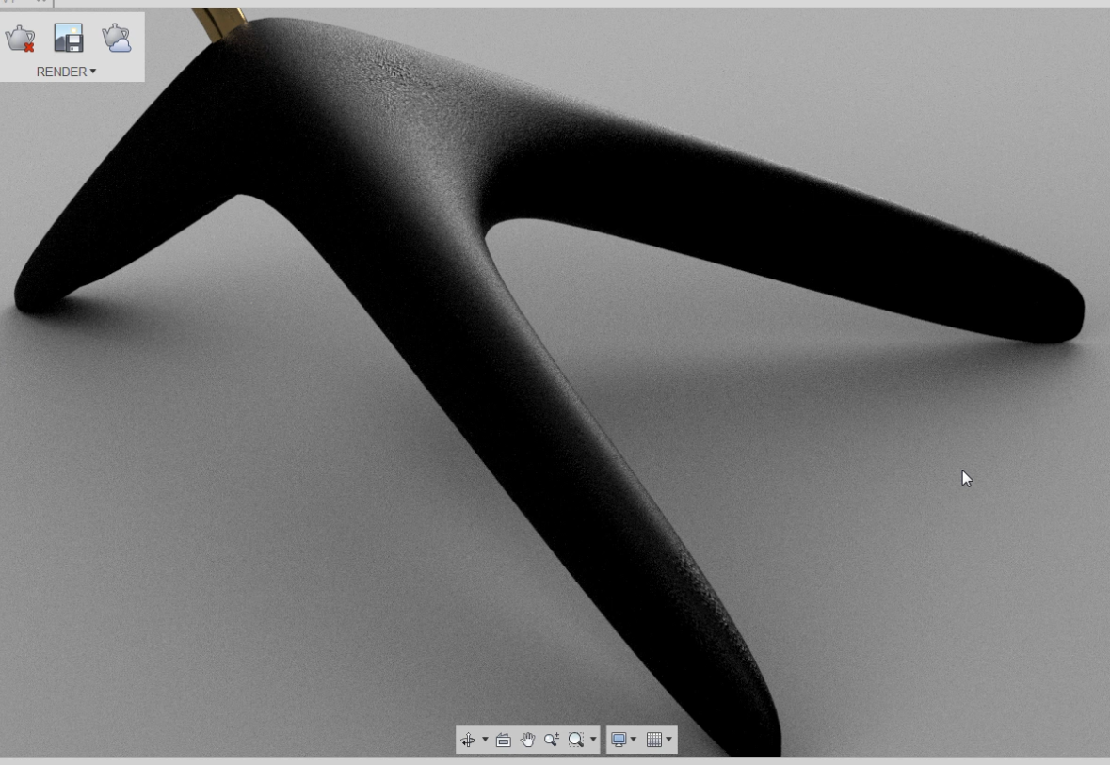
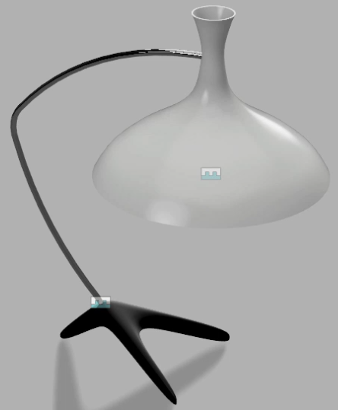
Fusion 360 Training: The Future of Making Things
Demonstration

Slide 36
Fusion 360 Training: The Future of Making Things
Lesson 8: Render
Review
Create rendered images of the lamp

Slide 37
Fusion 360 Training: The Future of Making Things
Lesson 9: Export
Objectives
Review the export file format options
Create a file for 3D printing

Slide 38
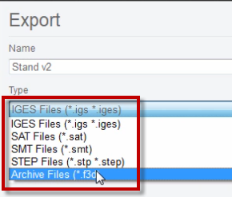
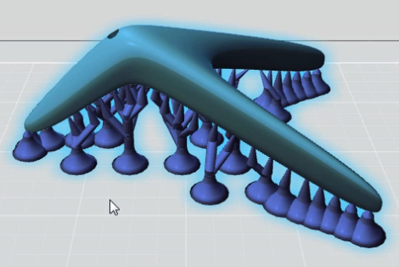
Fusion 360 Training: The Future of Making Things
Demonstration

Slide 39
Fusion 360 Training: The Future of Making Things
Lesson 9: Export
Review
Review the export file format options
Create a file for 3D printing

Slide 40
Fusion 360 Training: The Future of Making Things
Lesson 10: Collaborate
Overview
Invite people to the project
Review the share options

Slide 41
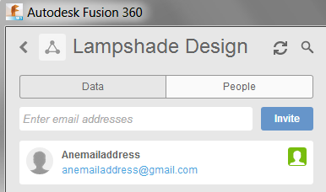
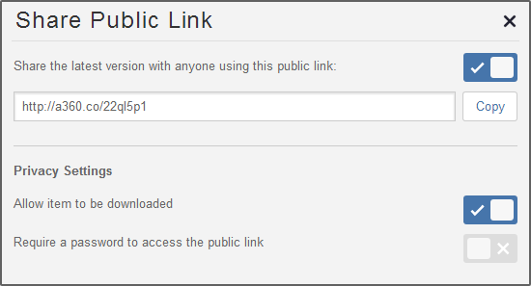
Fusion 360 Training: The Future of Making Things
Demonstration

Slide 42
Fusion 360 Training: The Future of Making Things
Lesson 10: Collaborate
Review
Invite people to the project
Review the share options

Slide 43
Engaging with Autodesk
Notes:
I would like to pause now and thank you for you attention and for taking the time to hear about Autodesk’s Digital Prototyping concept.
I value your opinion of my presentation and its contents and at this time I would like to welcome all question or comments.
[After Q&A is complete]
<Next Slide>

Slide 44
Engaging with Autodesk
Autodesk Design Academy
Free* access to Fusion 360 software and learning
content for students, educators, academic
institutions and start ups.
academy.autodesk.com
Educational licenses for individual use at home or school
Educational licenses for institutional use inside classrooms or computer labs
Unlock student creativity with free projects and courses to introduce students to new technologies and practices in 3D design
*Free Autodesk software and/or cloud-based services are subject to acceptance of and compliance with the terms and conditions of the software license agreement or terms of service that accompany such software or cloud-based services. Software and cloud-based services subject to an Educational license may be used solely for Educational Purposes and shall not be used for commercial, professional or any other for-profit purposes. http://usa.autodesk.com/legal-notices-trademarks/
Notes:
Autodesk is dedicated to help inspire, engage, and prepare students for academic and career success. The next generation of designers, innovators, and creators are your students today. Help them realize their potential with free access to professional design software used by millions of engineers and designers and create a better world. Add Autodesk tools to your curriculum using learning resources mapped by discipline and curriculum standard. Quality professional tools, real-world design projects, and competitions fuel a lifelong love of learning, problem solving, collaboration, and creative thinking—essential skills for 21st-century careers.
Students and educators have free access to individual downloads of Autodesk software through our Autodesk Education community. Current versions of the same software used by industry professionals help students nurture their designs through ideation, iteration, and final presentation.
Autodesk offers free access to product suites to academic institutions through the Academic Resource Center (ARC).
Autodesk Design Academy helps educators introduce students to the world of design with free, hands-on supplementary projects and course materials that help keep them current with 21st-century skills and concepts. Access the many BIM projects offered on the site to help enhance your curriculum with the continuously growing collection or projects and lessons.
As the industry changes, new roles are being created in firms and companies. Your students will someday be BIM managers and interactive designers. They will interact with UX designers to create interactive spaces. Digital fabrication and pre-fabrication are playing important roles in building design and almost every major design school is now teaching the fundamentals of prefabrication. Buildings and cities will be manufactured rather than constructed. As we prepare design for the internet of things and buildings, students will someday be responsible for not only “concretization” of the building as object, but also for orchestrating a new context—a dynamic system of elements that flexes and adapts to support human needs for environmental, behavioral, and social settings. Make sure your students are ready. Introduce them to free software from Autodesk and help them on the road to their new and exciting careers.

Slide 45
Autodesk Design Academy Learning resource types
Curriculum
How To Videos
Inspiration Stories
Curriculum is project-based with hands-on activities that promotes design thinking and creativity and is aligned to academic standards
Help students get started in design with skill-building videos that provides single topic information
Hear from your peers about how they are inspiring the next generation of designers

Slide 46
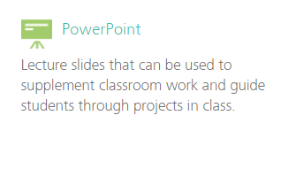
Autodesk Design Academy Project resources
Instructor resources
Use our curriculum and projects**
As a turnkey solution inside the classroom
Use parts to reinforce your own curriculum inside or outside the classroom
Remix with variations with attribution to Autodesk
Student resources
**All Autodesk Design Academy curriculum and projects are licensed under a Creative Commons Attribution-NonCommercial-ShareAlike 3.0 Unported License.

Slide 47
Design for Autodesk Program
www.autodesk.com/designforautodesk
Use Autodesk Fusion 360 to model an assembly with ~15 or more unique components that have a level of complexity beyond basic extrudes and revolves
Provide feedback to the Autodesk Fusion 360 product team
We’ll reward you for your time & effort with a $250 Visa gift card
Can submit two assemblies for a total of $500

Slide 48
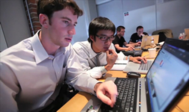
Student Expert Program
What does it offer?
Learn new skills and gain practical experience before you graduate
Connect with like-minded peers from all over the world
Be invited to Autodesk events and competitions
Get access to exclusive offers from Autodesk partners
Improve your career opportunities through Autodesk Certification
Network with Autodesk industry partners and customers
What do you do?
Join become a member of the global network
Contribute share your projects and interact with members
Earn Points for active engagement inside the network and for activities outside the network
Get Rewarded status invitations, exclusive opportunities and more!
Find Jobs
Sign up now @ www.studentexpert.net
Notes:
Here in Autodesk Education, our goal with each of our active student experts is to help get them trained, connected, experienced, and hired out in industry. The more active and involved in the program you are the more we can help you to accomplish this. Here are a couple of the many success stories that have come through the Student Expert program. This could be you.

Slide 49
Q&A
Notes:
I would like to pause now and thank you for you attention and for taking the time to hear about Autodesk’s Digital Prototyping concept.
I value your opinion of my presentation and its contents and at this time I would like to welcome all question or comments.
[After Q&A is complete]
<Next Slide>

