Slide 1
6th Annual MoodleMoot Virtual Conference, August 4-6, 2017
MMVC17
Using Moodle in Collaborative Interdisciplinary Group Projects
(Engineers-Physicians Case Study)
Anna Grabowska, Ewa Kozłowska
PRO-MED, Gdańsk University of Technology

Slide 2
Why interdisciplinary?
The demand for innovation in medical devices designing,
Lack of consultations in may lead to dangerous an even harmful situations.

Slide 3
Why don't we collaborate?
Sense of rivalry,
Constant lack of time,
Inconviniences.

Slide 4
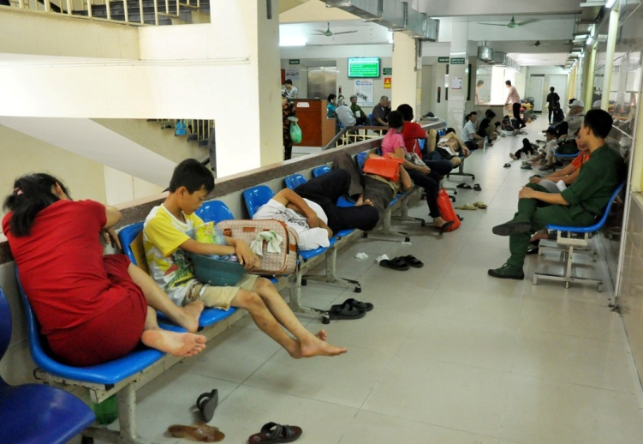
When engineer comes to a doctor...
expectations
reality

Slide 5
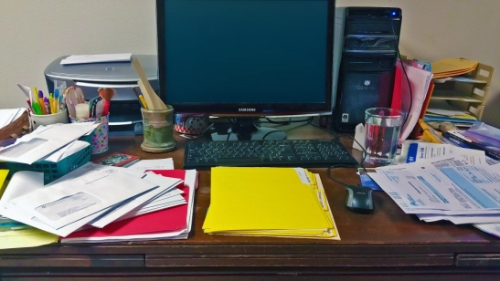
RESPECT
RESPECT
or
or
or

Slide 6
Why not online?

Slide 7
Using appropriate online collaboration tools makes interdisciplinary designing faster and much more efficient

Slide 8
To-do list
Analysis
Selection
Implementation
Testing
Conclusions

Slide 9
Selection
intuitive
?
available
expensive
universal
simple
compatible
popular
multilingual

Slide 10
Choice
+

Slide 11
Let's find some volunteers

Slide 12
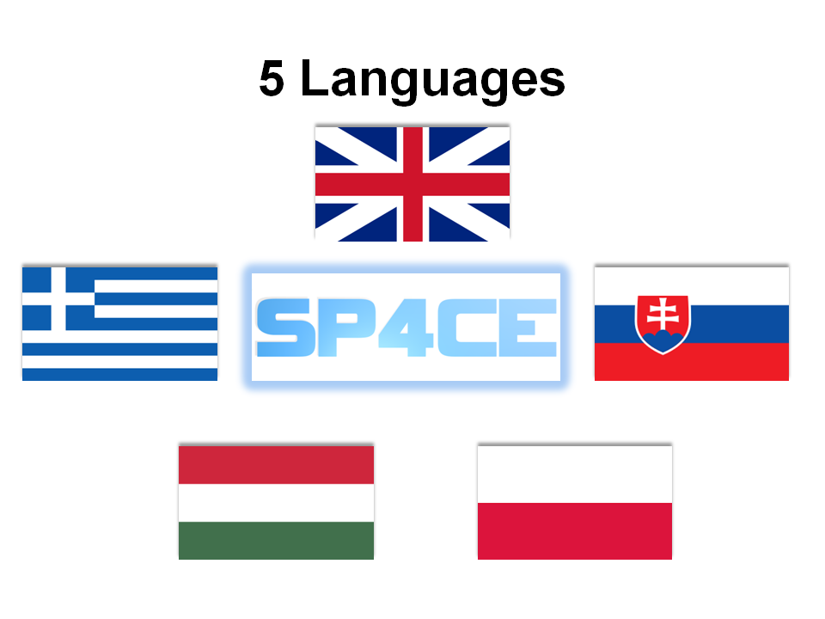
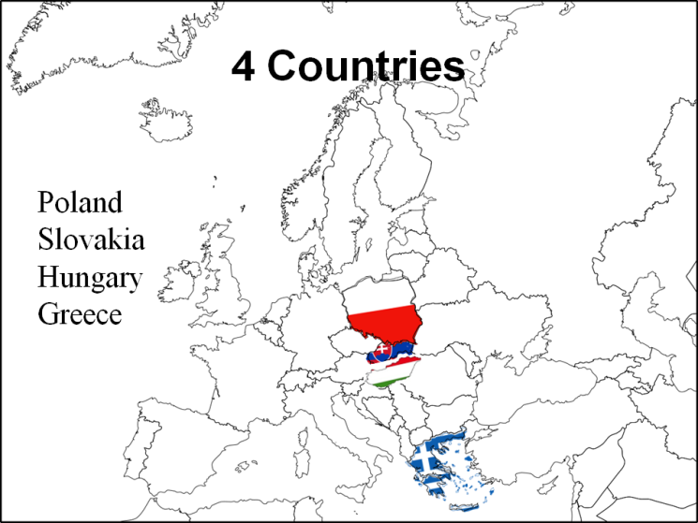

Slide 13
Autodesk Authorised Training Centre at the Gdańsk University of Technology
Mathematics Teaching and Distance Learning Centre at the Gdańsk University of Technology
European Multiple MOOC Aggregator
Scientific Circle at the Department of Radiology at the Medical University of Gdansk
Integrating Technology & Moodle for Teachers Network
PRO-MED sp. z o. o.
Student Scientific Circle of Maxillofacial Surgery at the Medical University of Gdańsk

Slide 14
Collaboration

Slide 15
CASE STUDIES

Slide 16
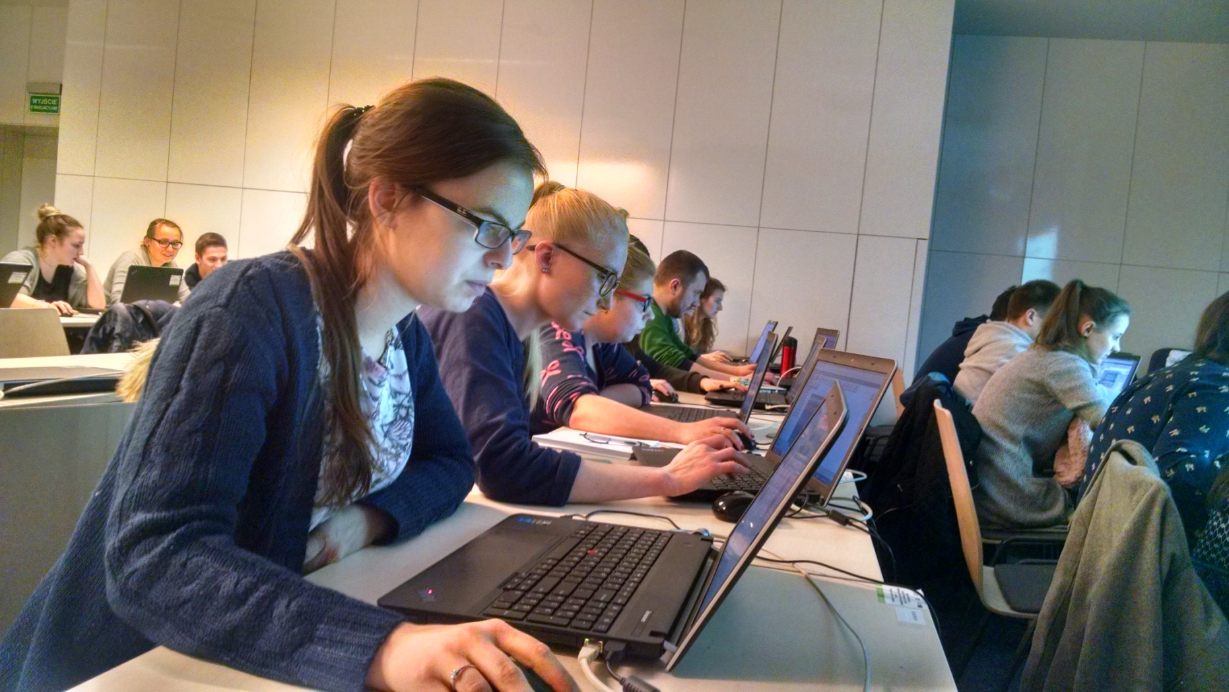
Workshops

Slide 17
Autodesk Fusion 360 Designathon

Slide 18
Autodesk Fusion 360 Designathon

Slide 19
Autodesk Fusion 360 Designathon – Day 1st

Slide 20
Autodesk Fusion 360 Designathon – Day 1st

Slide 21
Autodesk Fusion 360 Designathon – Day 2nd

Slide 22
Autodesk Fusion 360 Designathon – Day 2nd

Slide 23
European Multiple Mooc Aggregator

Slide 24
Students' Apprenticeship
Communication
Resources
Work documentation

Slide 25
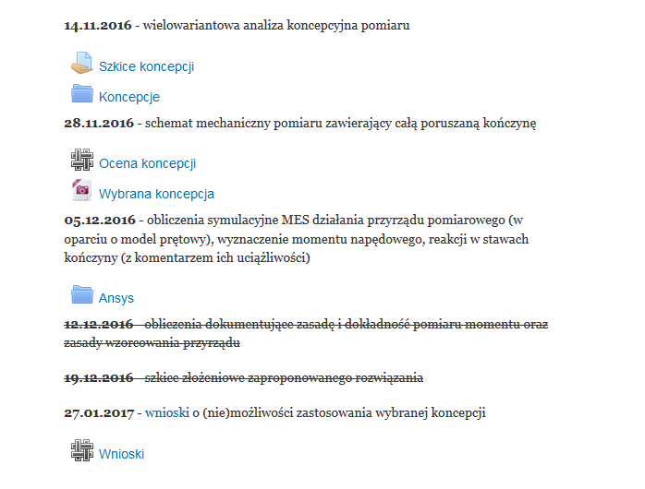
Group Projects
General part
Schedule

Slide 26
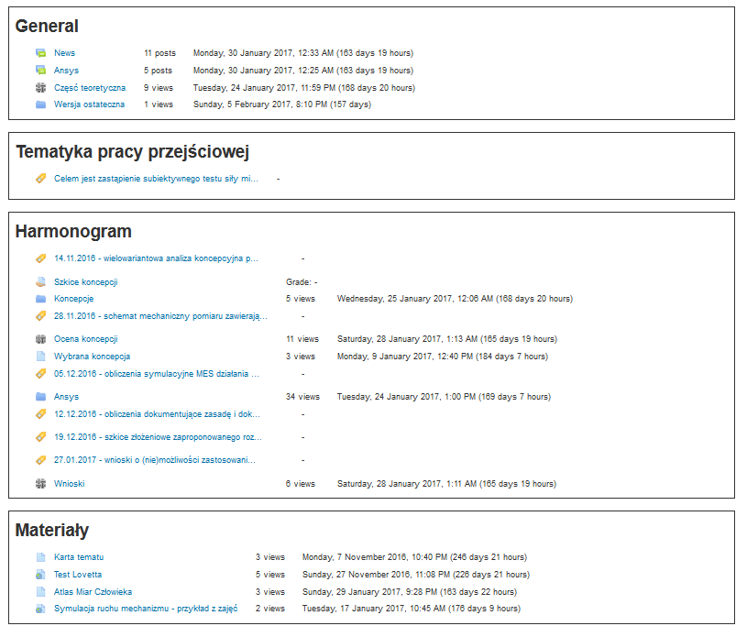
Engagement comparison

Slide 27
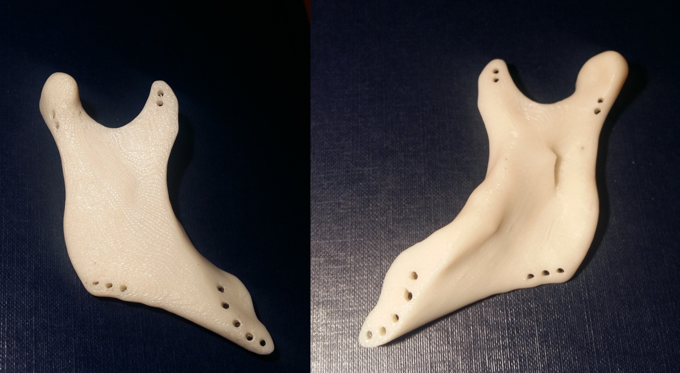
Diploma Projects
Design and material selection for the jaw implant after bone resection

Slide 28
Scientyfic Circles

Slide 29
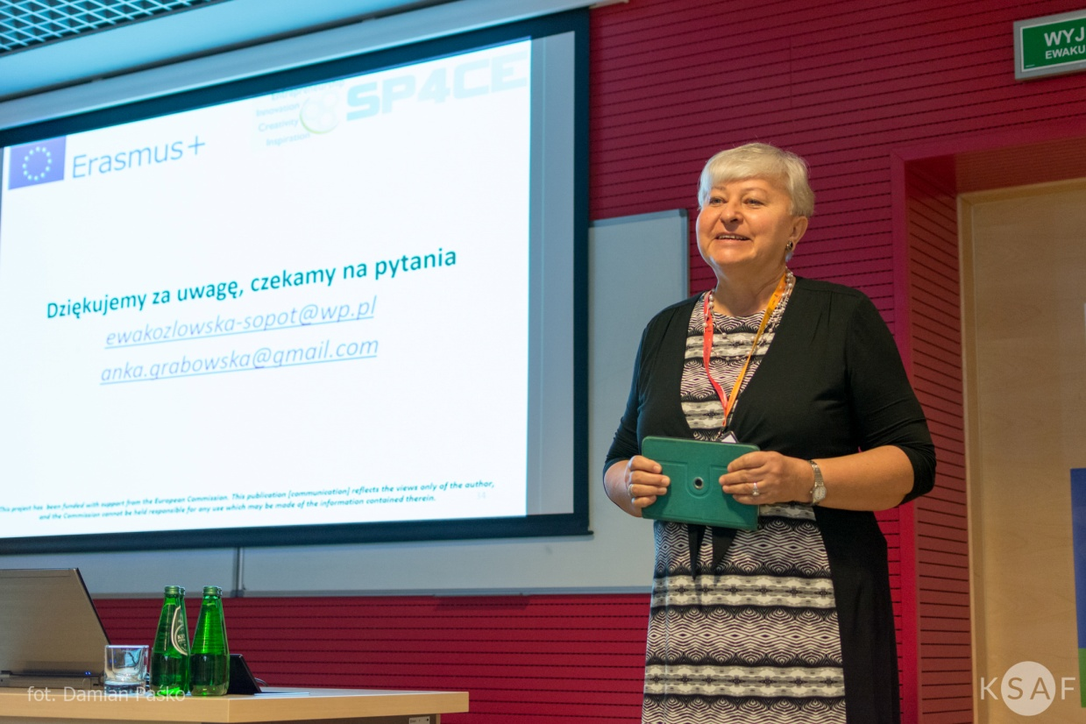
Conferences

Slide 30
14
Articles
Posters
Speeches
Webinars
Workshops
conferences in 1 year

Slide 31
Sharing the ideas
https://youtu.be/1t3LVEOR7Gw

Slide 32
TECHNICIAN
Computer Tomography
RADIOLOGIST
Diagnosis
MOODLE
Consultations
Sharing
Treatment planning
ENGINEER
FUSION 360
ENGINEER + PHYSICIAN
Surgical template
SURGEON
3D Model
Individual implant
Sterilization,
Surgery,
Postoperative control
Consultations
Prototype

Slide 33
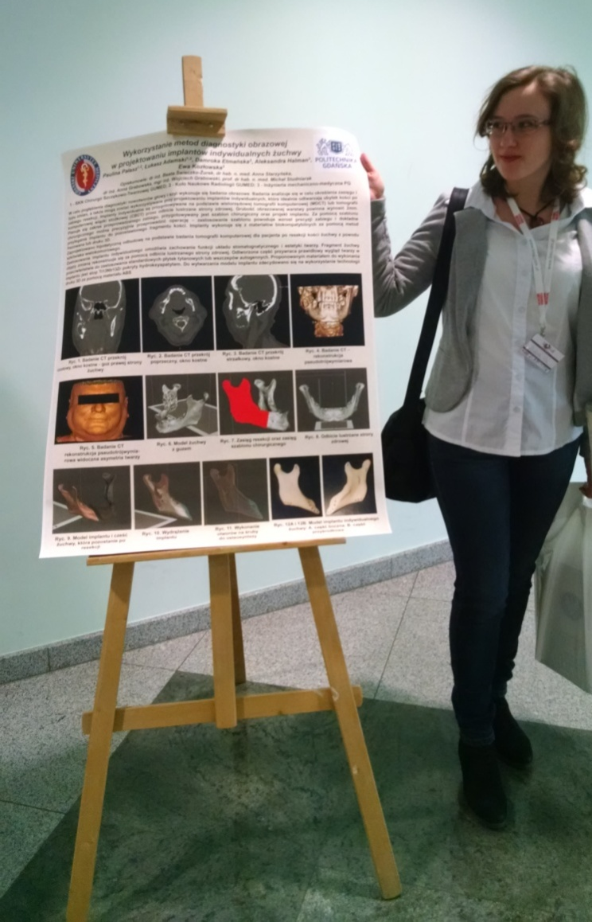
Showing the effects worldwide

Slide 34
Participants of the eTEE 2017 (the 4th Conference e-Technologies in Engineering Education)

Slide 35
Summing up
Category | Number of LR
Autodesk Academic Partner | 8
Greece - IDEC | 14
Poland - PIAP, PRO-MED. | 66
Hungary - TREBAG | 16
Slovakia - ASTRA, TUKE | 8
Others | 6

Slide 36
118
Summing up
Learning Rooms

Slide 37
450
Summing up
Registered users from all over the world

Slide 38
282
Summing up
Poland
168
Belgium, Brazil, Bulgaria, Croatia, France, Germany, Greece, Hungary, Netherlands, Norway, Portugal, Romania, Russian Federation, Slovakia, Spain, Sweden and UK

Slide 39
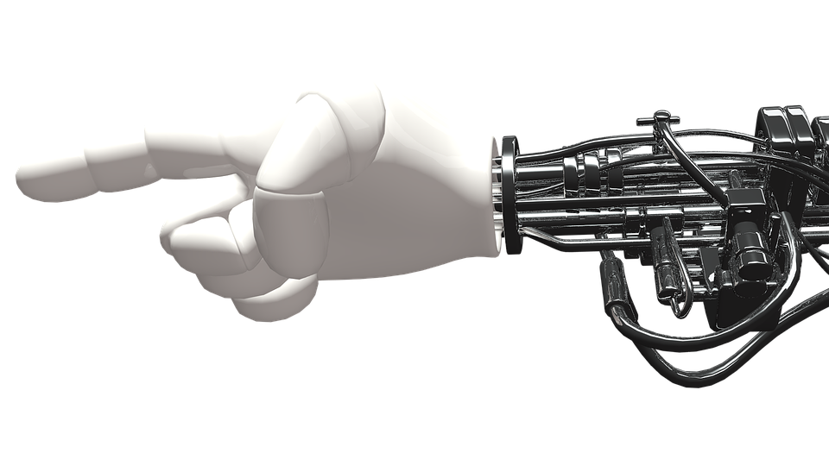
To do interdisciplinary designing means to:
compete
collaborate
communicate
cooperate

Slide 40
Thank You!
MMVC17
.
.
.
http://sp4ce.moodle.pl/
Anna Grabowska
Ewa Kozłowska
Notes:
https://www.facebook.com/groups/1648317032157787/
http://sp4ce.moodle.pl/

Slide 41
References
Czaja Anna, Chylińska Karolina, Grabowska Anna, Grabowski Wojciech, Kozłowska Ewa, Pałasz Paulina: Od koncepcji po prototyp, czyli przychodzi inżynier do lekarza, III Kongres Rozwoju Edukacji, Kraków 2016.
Czaja Anna, Grabowska Anna, Kozłowska Ewa, Pałasz Paulina: Przykłady dobrej praktyki w projekcie SP4CE ERASMUS+, Zeszyty Naukowe Wydziału Elektrotechniki i Automatyki Politechniki Gdańskiej, IV Konferencja e-Technologie w Kształceniu Inżynierów, Wydawnictwo Wydziału Elektrotechniki i Automatyki Politechniki Gdańskiej 52/2017, Gdańsk 2017, s. 19-24.
Grabowska A., Czaja A., Kozłowska E., Pałasz P.: MOOCs in SP4CE - case studies (Strategic Partnership for Creativity and Entrepreneurship), 14th IEEE International Conference on Emerging eLearning Technologies and Applications, Starý Smokovec, The High Tatras, Slovakia, November 24 – 25, 2016, ISBN: 978-1-5090-4699-7, IEEE Catalog number: CFP1638M-CDR, s. 73-78.
Grabowska Anna, Kozłowska Ewa: Moodle MOOCs - przypadki użycia w projekcie SP4CE (partnerstwo strategiczne na rzecz kreatywności i przedsiębiorczości), Zeszyty Naukowe Wydziału Elektrotechniki i Automatyki Politechniki Gdańskiej, III Konferencja e-Technologie w Kształceniu Inżynierów, Wydawnictwo Wydziału Elektrotechniki i Automatyki Politechniki Gdańskiej 48/2016, Gdańsk 2016, s. 29-34.
Halman Aleksandra, Etmańska Damroka: Projekt i dobór materiału na implant żuchwy po resekcji kości, Projekt dyplomowy inżynierski, Wydział Mechaniczny, Politechnika Gdańska, 2017.
Kozłowska Ewa: Medical devices designing with the usage of computer collaboration tools by engineers and physicians, Praca dyplomowa magisterska, Wydział Mechaniczny, Politechnika Gdańska, 2017
http://sp4ce.moodle.pl/
https://www.facebook.com/groups/1648317032157787/
https://youtu.be/1t3LVEOR7Gw
https://pixabay.com/pl/

