Slide 1
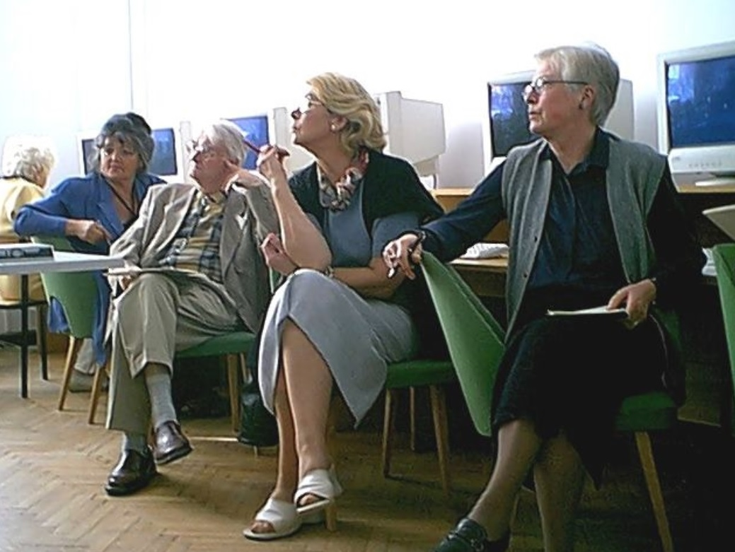
Teaching Adults Online Meetings with computers for 60, 70, 80+
Dr. Eng. Anna Grabowska
anka.grabowska@gmail.com
http://jatobym.moodle.pl/

Slide 2
Agenda
Introduction (About me, Let's go back to the past....)
Good practice (Learn with Grandma, City Games, Tourism, etc.)
Projects
U3A online
Final thoughts
Questions and Answers (Q&A)

Slide 3
About me
I have more than 40 years educational experience and since 1993 I have been participating in EU educational projects for students and the elderly. All of them integrate the latest achievements in ICT in the training programme.
One of the most significant achievements was the participation in the Leonardo da Vinci project (1998-2001) Teleworkers training for CAD System Users. TeleCAD was the winner of the Open Competition of the best e-learning projects in 2005. The system is still active and offered for adult learners including 50+.
Since 10 years I have been conducting meetings with the computer for seniors at Gdansk University of Technology.
I have been a developer and an administrator of e-learning platforms for seniors: http://utw.moodle.pl, http://jatobym.moodle.pl/ and Facebook groups ADM - senior.eu@gmail.com.
Since 2013 the chosen OER are available on the Academic Computer Centre in Gdansk server - CI TASK.

Slide 4
Let's go back to the past....
Meeting of Generations (2001-2003)
and Active Citizens (
Active Citizens – Learn with Grandma (2011)

Slide 5
Good Practice – Learn with Grandma (2011) U3A-SACE INTERNATIONAL CONFERENCE 2011 SINGAPORE, 8-9 August

Slide 6
Learn with Grandma & Active Citizens (2011)

Slide 7
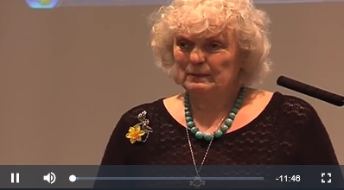
Good Practice – Learn with Grandma (2012)

Slide 8
Learn with Grandma - Aims
To encourage parents & grandparents to instill a love of learning; create lasting memories & have FUN with their grandchildren.
Primary aim is encourage respect between the generations and encourage inter- generational & e-learning.
Each generation has skills that they can learn from each other – encouraging older people to learn technology skills from younger people who will help them record traditional skills.
To encourage older people to share traditional skills; especially those that – when combined with modern technical skills – could create employment for young people and those aged 50+.
To create local & internet support networks for grandparents, parents & children.
To research educational, and fun, activities and resources that grandparents can do with their grandchildren - including virtual activities.
To work with organisations in other countries to promote our aims internationally.
To encourage communities to work together to preserve their history; culture and folk stories.
Encouraging the creation of e-books as a method of uniting the generations; Creating educational material that will be made available digitally via Grandma’s Digital Library.

Slide 9
City Games since 2012
Initially, the games were a part of Grundtvig's partner projects.
In 2012 the first game was created "Old Gdansk" for foreign guests from England, France, Spain, Germany, Turkey.
The game was translated into selected partner languages ​​(English, Turkish).
Similar games were played in Carpentras in France and in Rome.
By June 2014 around 100 seniors were involved in the city games.
The first stage of the game is to involve 60+ volunteers and young instructors in the process of creating games in urban space and developing a map (including photos) and instructions.
The second stage is the physical participation in a city game in teams.
In 2014 the project was submitted as a proposal within the framework of the competition and the following city games were created: Gdańsk, Oliwa, Zaspa, Przymorze, Wrzeszcz, Westerplatte. An example game took place in Reagan Park on 30 October 2014.

Slide 10
An Invitation for „City Games”

Slide 11
City Games Repository on TASK Server

Slide 12
The Contest - Maturity in the Network Good Pracitce (2015)

Slide 13
Senior Acting Together – 2014

Slide 14
Senior Acting Together – 2014

Slide 15
https://www.facebook.com/groups/100160903745678/

Slide 16
Is Georgia in Europe, 2016 – 2017 LMS Moodle

Slide 17
Is Georgia in Europe, 2016 – 2017 Facebook

Slide 18
U3A online - what is all about

Slide 19
Projects, 2005 – 2017 (1)
Socrates Grundtvig, ABLE - Adult Blended Learning, 2005-2007
Grundtvig Multilateral Project, MindWellness - Improving learning capacities and mental health of elder people, 2008-2010 https://www.ttk.ee/en/mindwellness-improving-learning-capacities-and-mental-health-elder-people-122008-112010, http://docplayer.pl/26044-Podrecznik-do-cwiczenia-umyslu-dla-osob-starszych.html, http://utw.moodle.pl/file.php/15/handbook/Handbook_Prototype.pdf
Magazine online, 2008-2017
Grundtvig Partnership, Connecting +55, 2008-2010
Grundtvig Partnership, EuBiA - EU Broadening people's mind in ageing, 2008-2010
Grundtvig Partnership, IMPROGE - Improving Opportunities for Older People in Work and Community Activity - Winning the Generation Game, 2008-2010
e-senior.eu w akcji, 2009-2010

Slide 20
Projects, 2005 – 2017 (2)
Grundtvig Partnership, LLLab - Lifelong Learning for Active Citizenship and Capacity Building, 2009-2011
Active Citizens, 2010-2011
Grundtvig Partnership, LISTEN - Learning Innovative Styles and Active Citizens, 2011-2013
Grundtvig Partnership, LLLE - Learning in Later Life in Europe, 2011-2013
Grundtvig Network Project, ForAge – Forage for later-life learning: Building on European experience, 2012-2014
Grundtvig Multilateral Project, MATURE - Making Adult Teaching Useful, Relevant and Engaging, 2013-2014
Grundtvig Senior Volunteering Project, SenAcT - Seniors Acting Together, 2013-2014
Narodowe Centrum Kultury, Gry miejskie – Aktywni 60+, 2014
ERASMUS+, SP4CE - Strategic Partnership for Creativity and Entrepreneurship, 2014-2017

Slide 21
Grandmothers' Fairy Tales Repository (1) Working in the SP4CE in Cloud…

Slide 22
Grandmothers' Fairy Tales Repository (2)

Slide 23
Grandmothers' Fairy Tales Facebook (3)

Slide 24
Final thoughts (1)

Slide 25
Final thoughts (2)

Slide 26
Final thoughts (3)

Slide 27
Questions and Answers (Q&A) login: guesterasmus

Slide 28
Q&A – how it works

Slide 29
e-mail: anka.grabowska@gmail.com

