Slide 1
Vertigo and dizziness
Ewa Bylińska 28th december 2020
How to prevent Vertigo? Vertigo - an interdisciplinary approach

Slide 2
„Whole life is now online”

Slide 3
Vertigo
is a sensation of feeling off balance. If you have these dizzy spells, you might feel like you are spinning or that the world around you is spinning.

Slide 4
Vertigo Symptoms
Spinning
Tilting
Swaying
Unbalanced
Pulled to one direction
Feeling nauseated
Vomiting
Abnormal or jerking eye movements (nystagmus)
Headache
Sweating
Ringing in the ears or hearing loss

Slide 5
Vertigo - causes
Inner ear disturbance
Motion sickness
Medication effects
Underlying health condition, such as poor circulation, infection or injury
Neurological conditions.
Anxiety disorders
Low iron levels (anemia)
Low blood sugar (hypoglycemia)
Carbon monoxide poison
Overheating and dehydration

Slide 7
How do I sit properly?
Keep your feet on the floor or on a footrest, if they don’t reach the floor.
Don’t cross your legs. Your ankles should be in front of your knees.
Leave small gap between the back of your knees and the front of your seat.
Your knees and hips at a 90º angles.
Adjust the backrest of your chair to support your low- and mid-back or use a back support.
Relax your shoulders and keep your forearms parallel to the ground.
Avoid sitting in the same position for long periods of time.

Slide 8
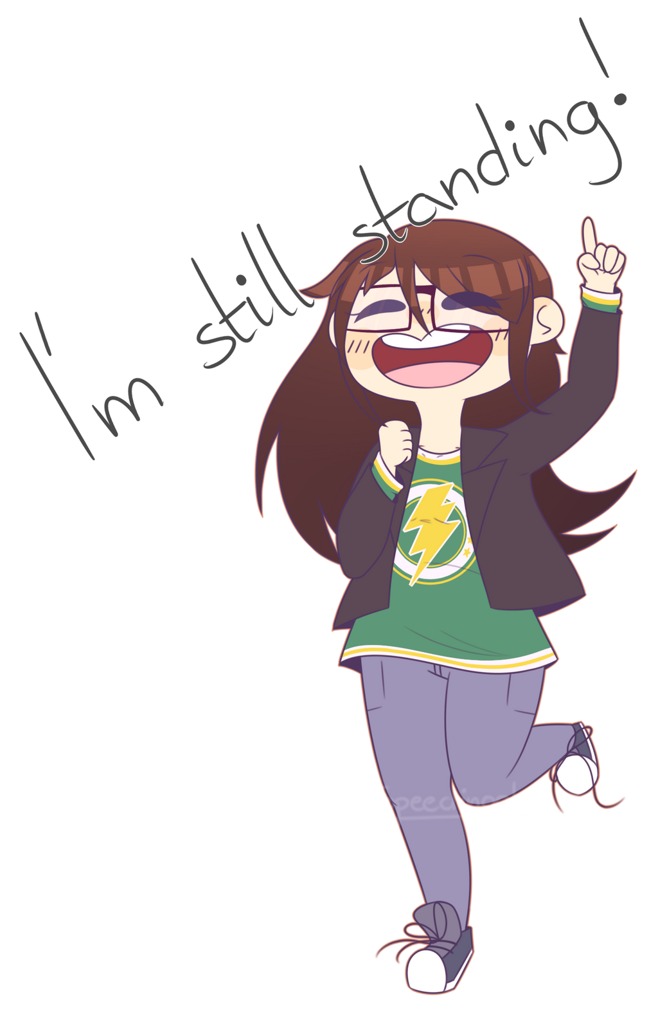
How do I stand properly?
Bear your weight primarily on the balls of your feet.
Keep your knees slightly bent.
Keep your feet about shoulder-width apart.
Stand straight and tall with your shoulders pulled backward.
Keep your head level-your earlobes should be in line with your shoulders. Do not push your head forward, backward, or to the side.
Shift your weight from your toes to your heels, or one foot to the other, if you have to stand for a long time.

Slide 9
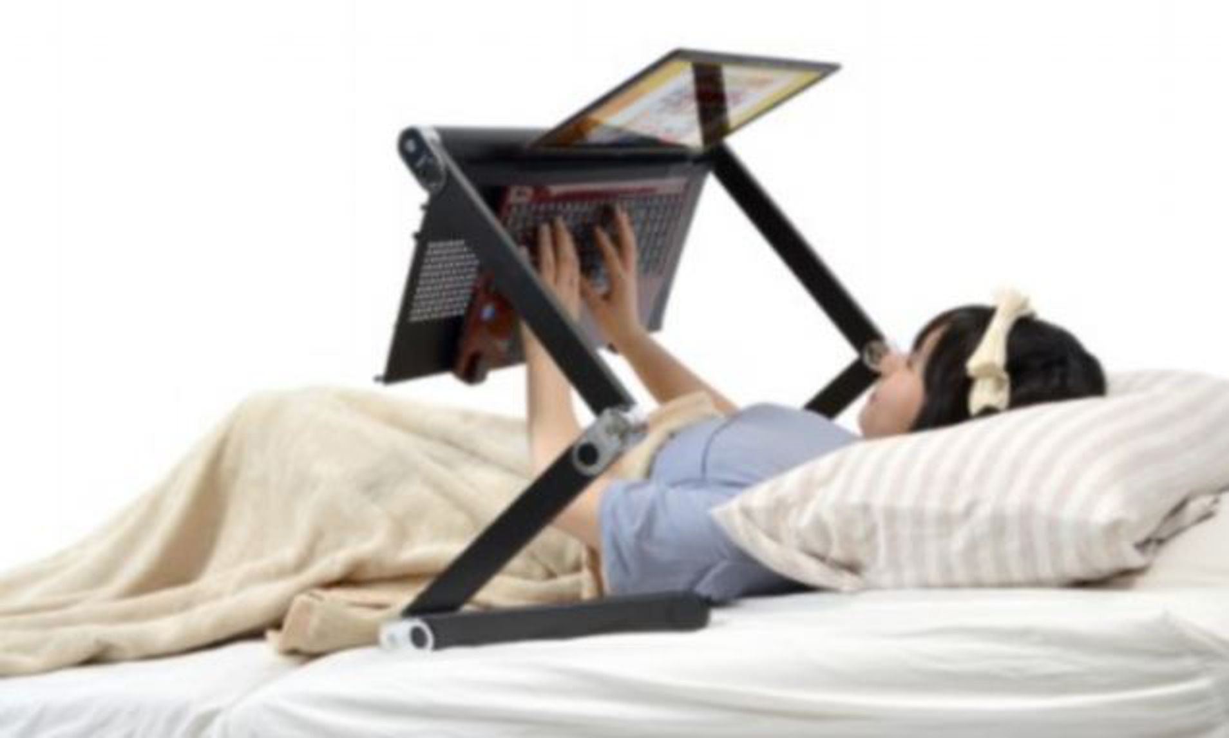
What is the proper lying position?
Find the mattress that is right for you. While a firm mattress is generally recommended, some people find that softer mattresses reduce their back pain. Your comfort is important. (Pillow Top/Pad)
Sleep with a pillow. Special pillows are available to help with postural problems resulting from a poor sleeping position.
Avoid sleeping on your stomach.
Sleeping on your side or back is more often helpful for back pain. If you sleep on your side, place a pillow between your legs. If you sleep on your back, keep a pillow under your knees.

Slide 10
The significance of physical activity
Advantageous effect on both body and mind, physical and psychological sides
Affects in a positive way systems within body: cardiovascular, respiratory, nervous, muscles, bones, joints, ligaments and immune system

Slide 11
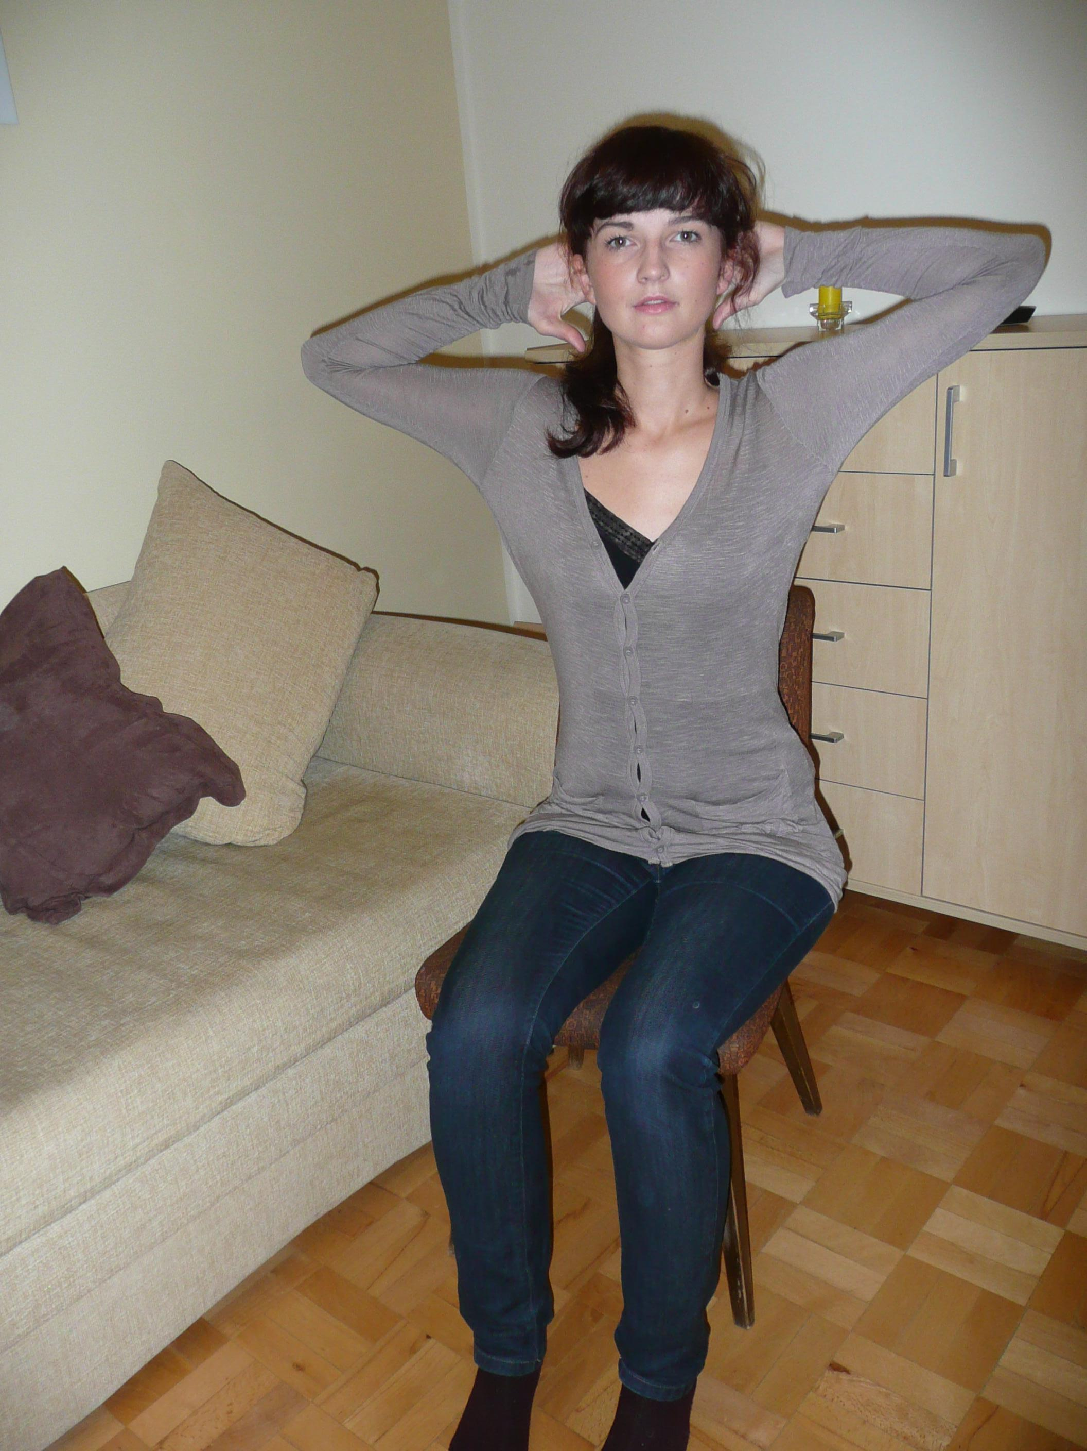
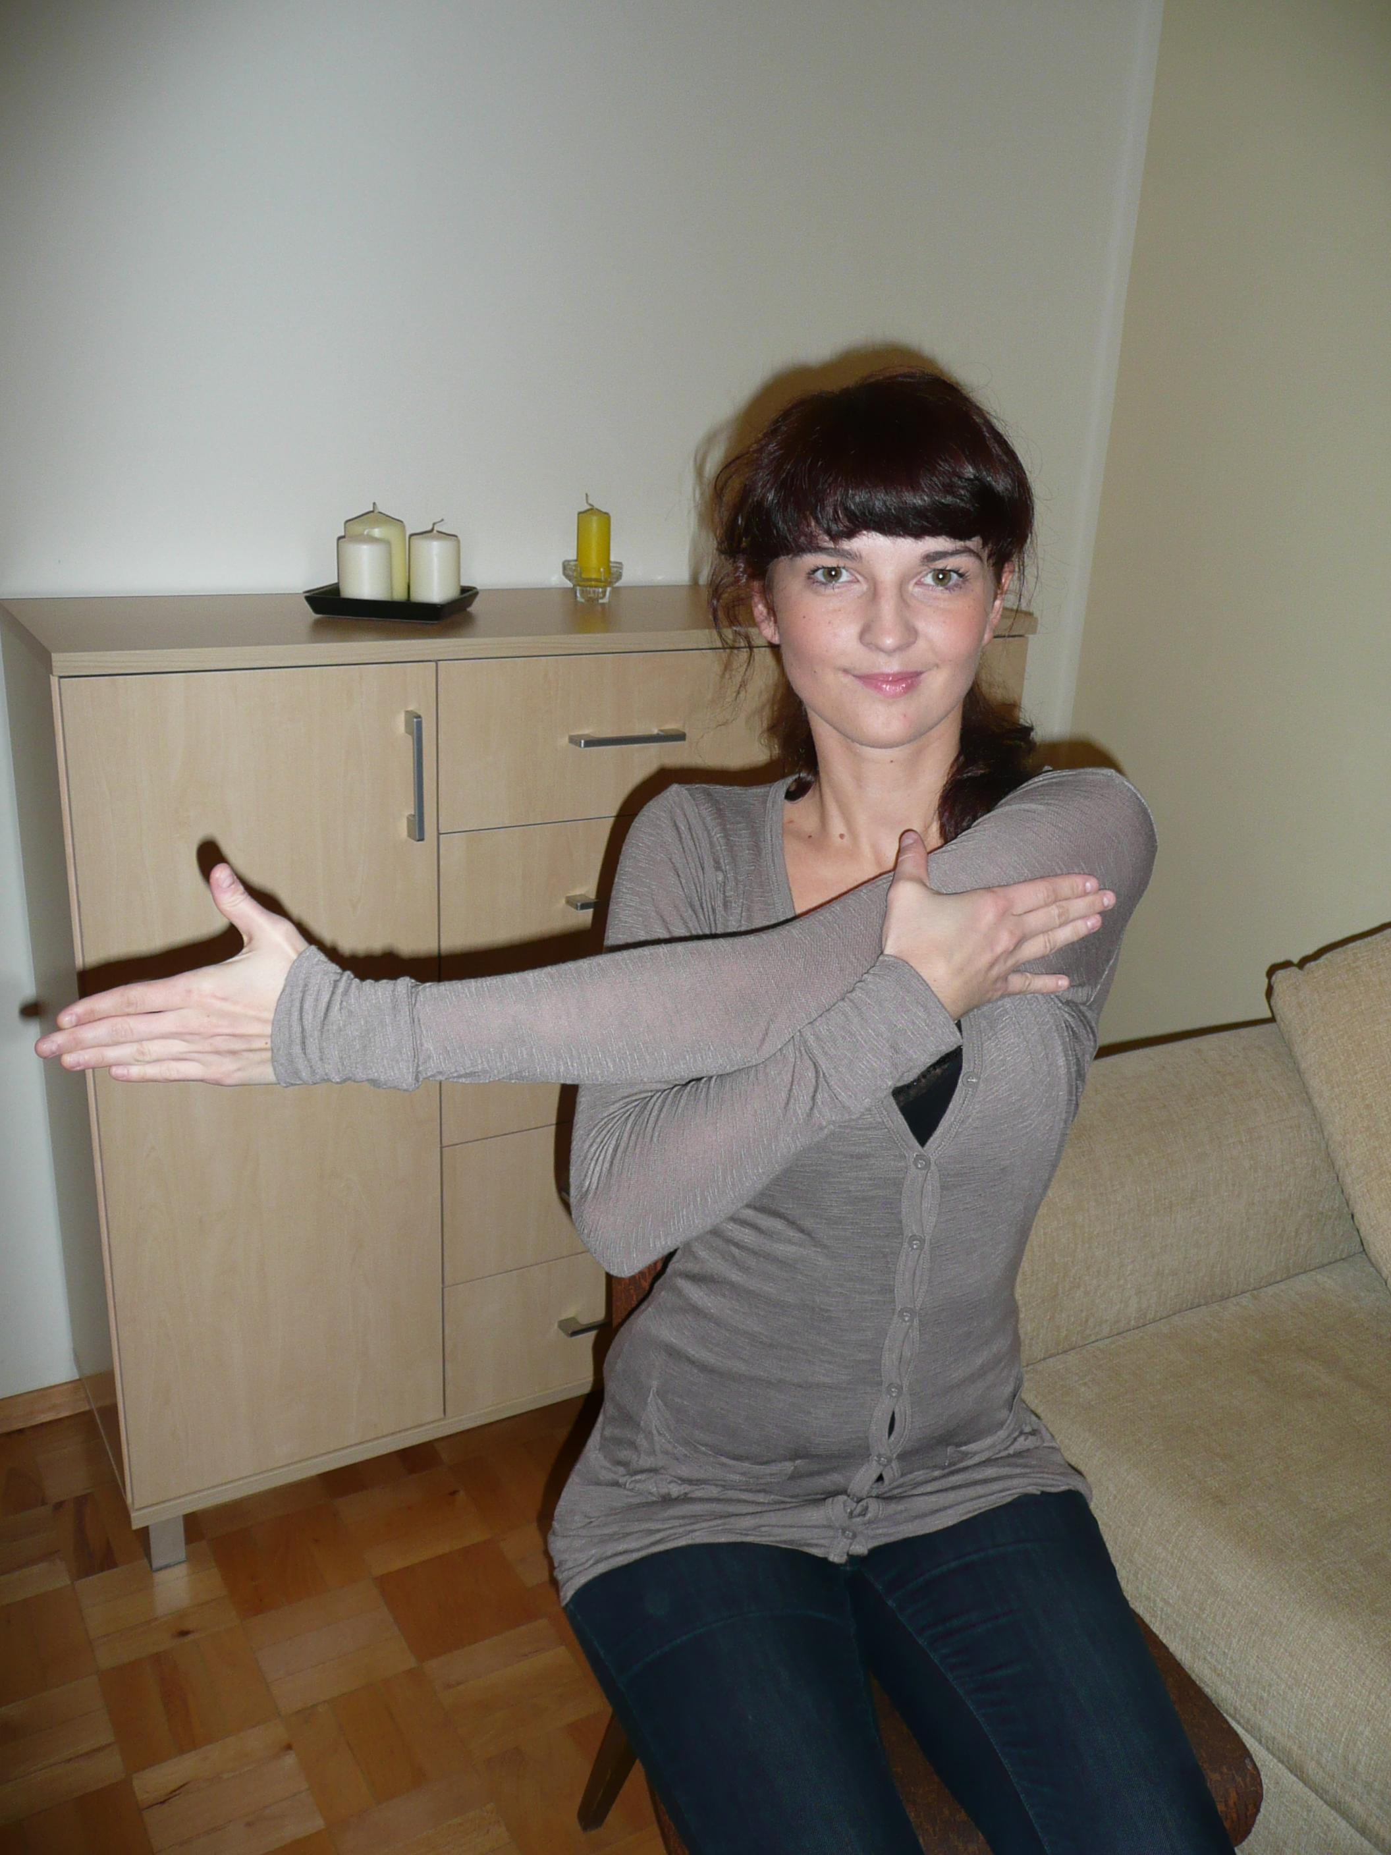
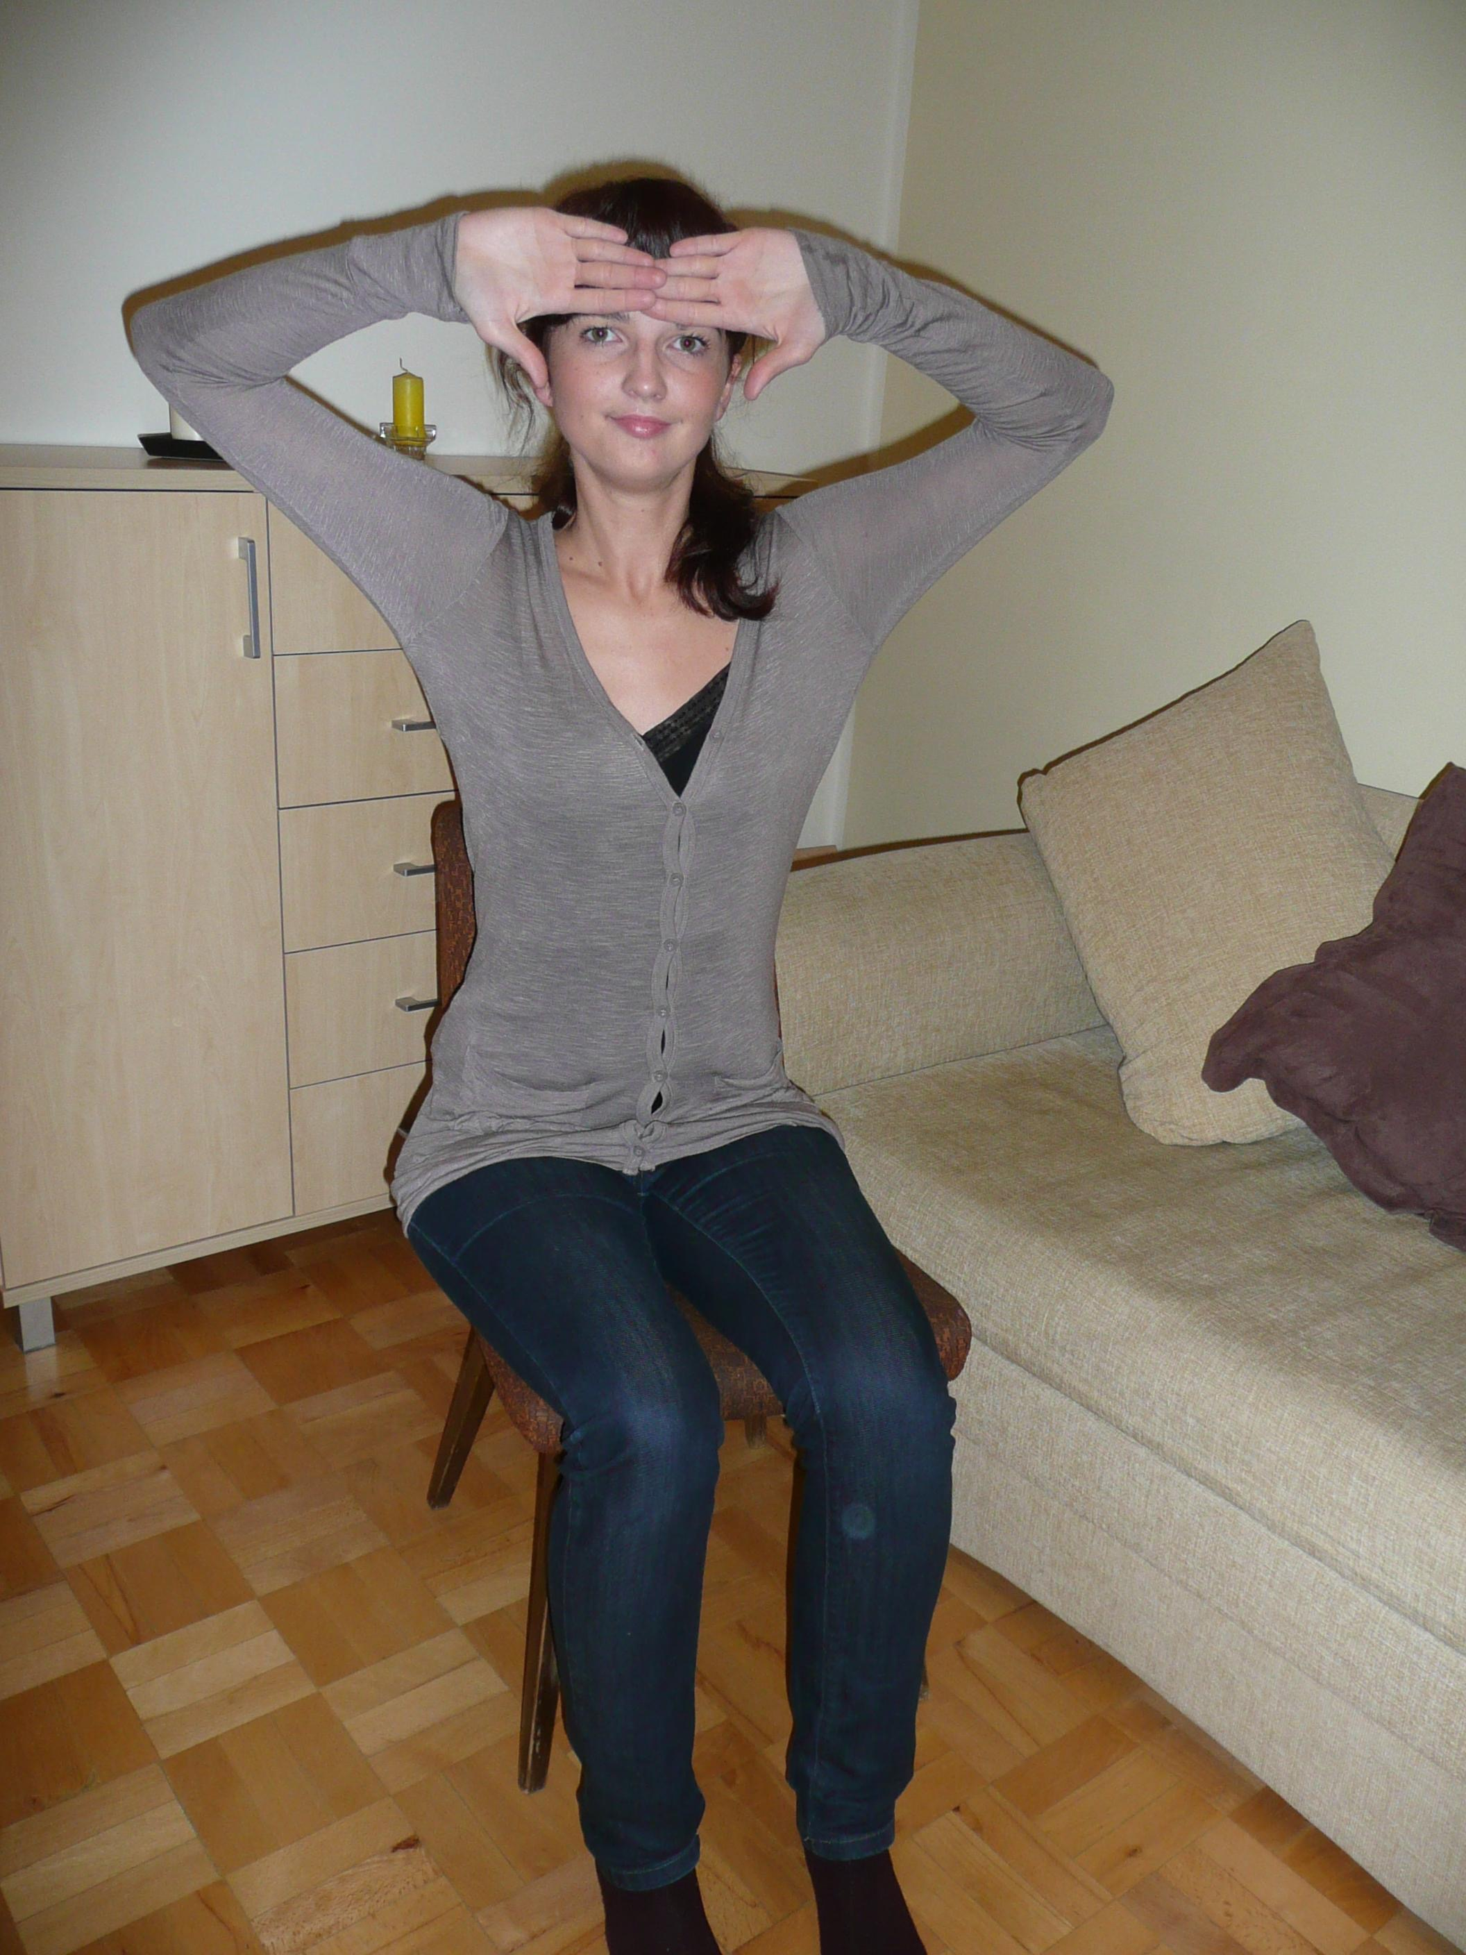
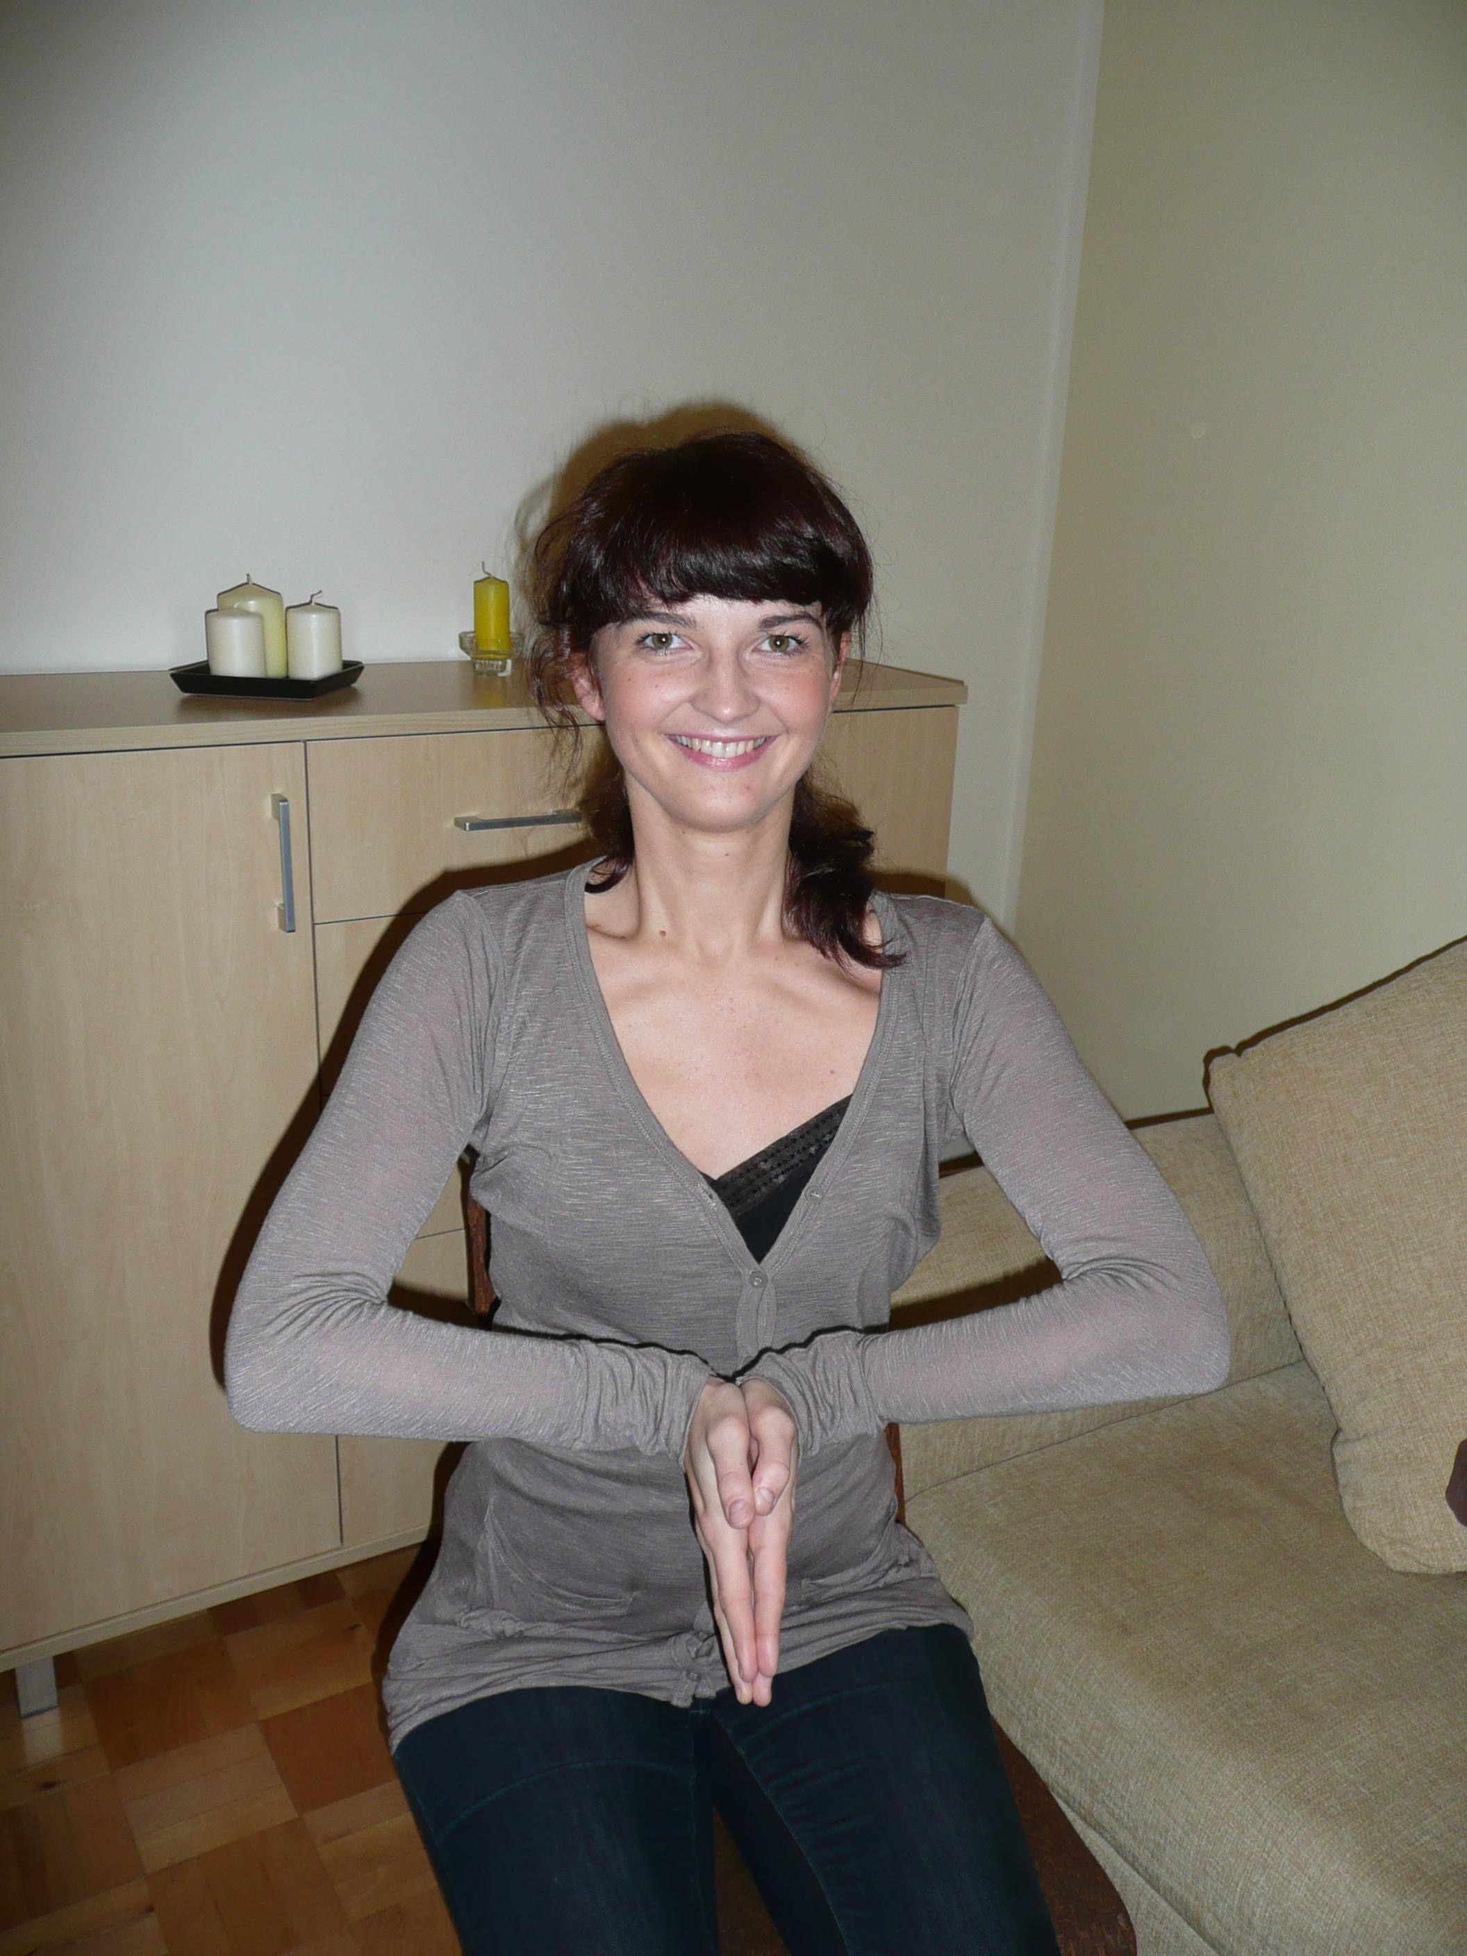
Mindfullness

Slide 12
Sustainability ???
Timeless???

